Slide 1
WolfieONE
Change Leader Network Training – Part 1
Nov 14, 2024
Office of Change Management
Notes:
HINA

Slide 2
Agenda
Recap
Change Management
WolfieONE – High Level Changes
Chart of Accounts (COA)
Oracle Cloud Overview
WolfieONE Modules; ERP, EPM, HCM
Processes under each module
HCM Known Change Impacts
Next Steps
Notes:
HINA Leader Network recap – “start with why” (2 min)
Change Management (10 min)
Modules; ERP, EPM, HCM (5 min)
Processes under each module (15-20 min)- stop for questions
COA (15 min)
HCM Known Change Impacts (10 min)

Slide 3
RECAP
Change Leader Network (CLN)
Notes:
HINA

Slide 4
What is a Change Leader Network?
An integral part of the Change Management Methodology at Stony Brook
A peer-led group of influencers and impacted users across Stony Brook who will assist in building awareness, active listening and gathering concerns, promoting buy-in, and providing support to stakeholders impacted by the project
An indispensable asset to drive and support change adoption
Reward & Recognize the Change Champions
Define the Roles and Responsibilities of the Change Leader Network
Follow Up with Nominated and Volunteered Candidates to Get Commitment
Ask the Managers to Nominate Candidates
Manage the Change Leader Network
Kick-off the Change Leader Network
Define the Criteria for Selection of Change Leaders
Provide an Overview to Managers of Potential Change Champions
Design Change Network Strategy
Develop Change Network Plan
We are here
Conduct training(s)
Socialize Network​
Leverage for driving change
Provide Support, as needed​
Gather feedback
Notes:
HINA

Slide 5
Getting Started with Change Management
Notes:
HINA

Slide 6
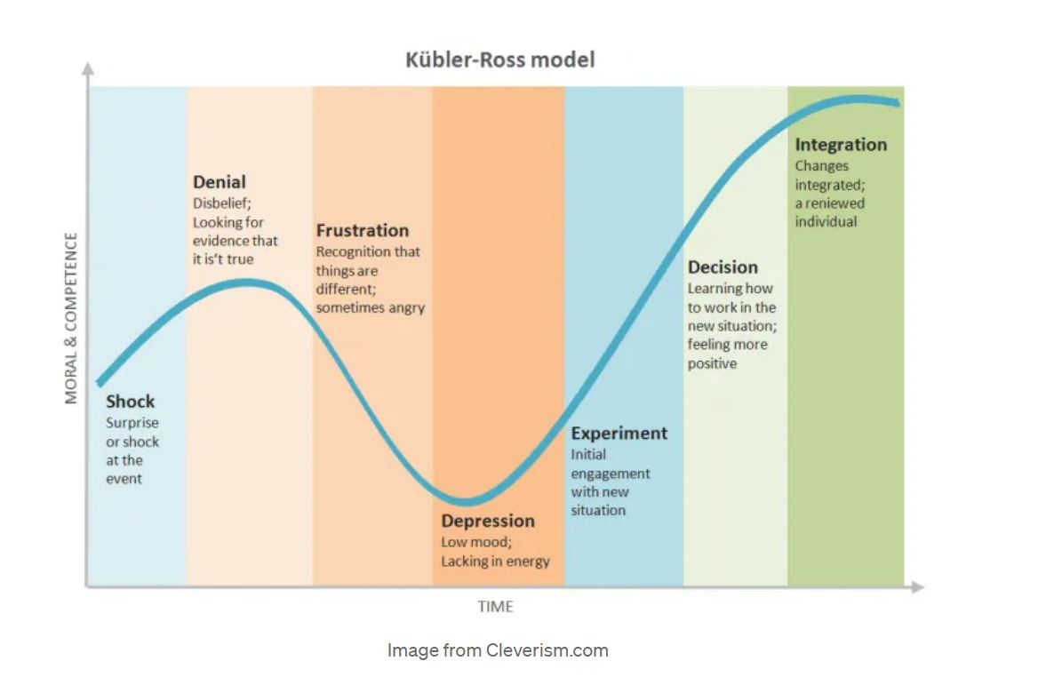
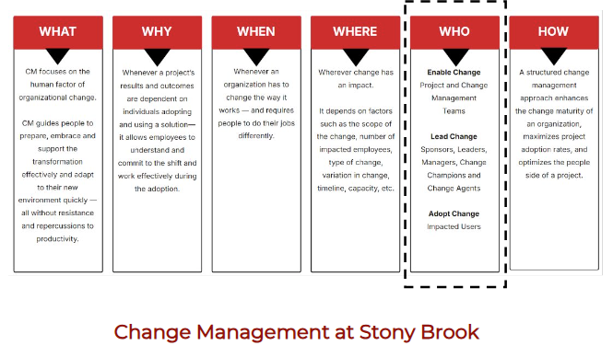
The Change Curve
It is natural for anyone to prefer the status quo, not because they are against change, but because humans naturally gravitate towards maintaining things as they are.
Notes:
HINA

Slide 7
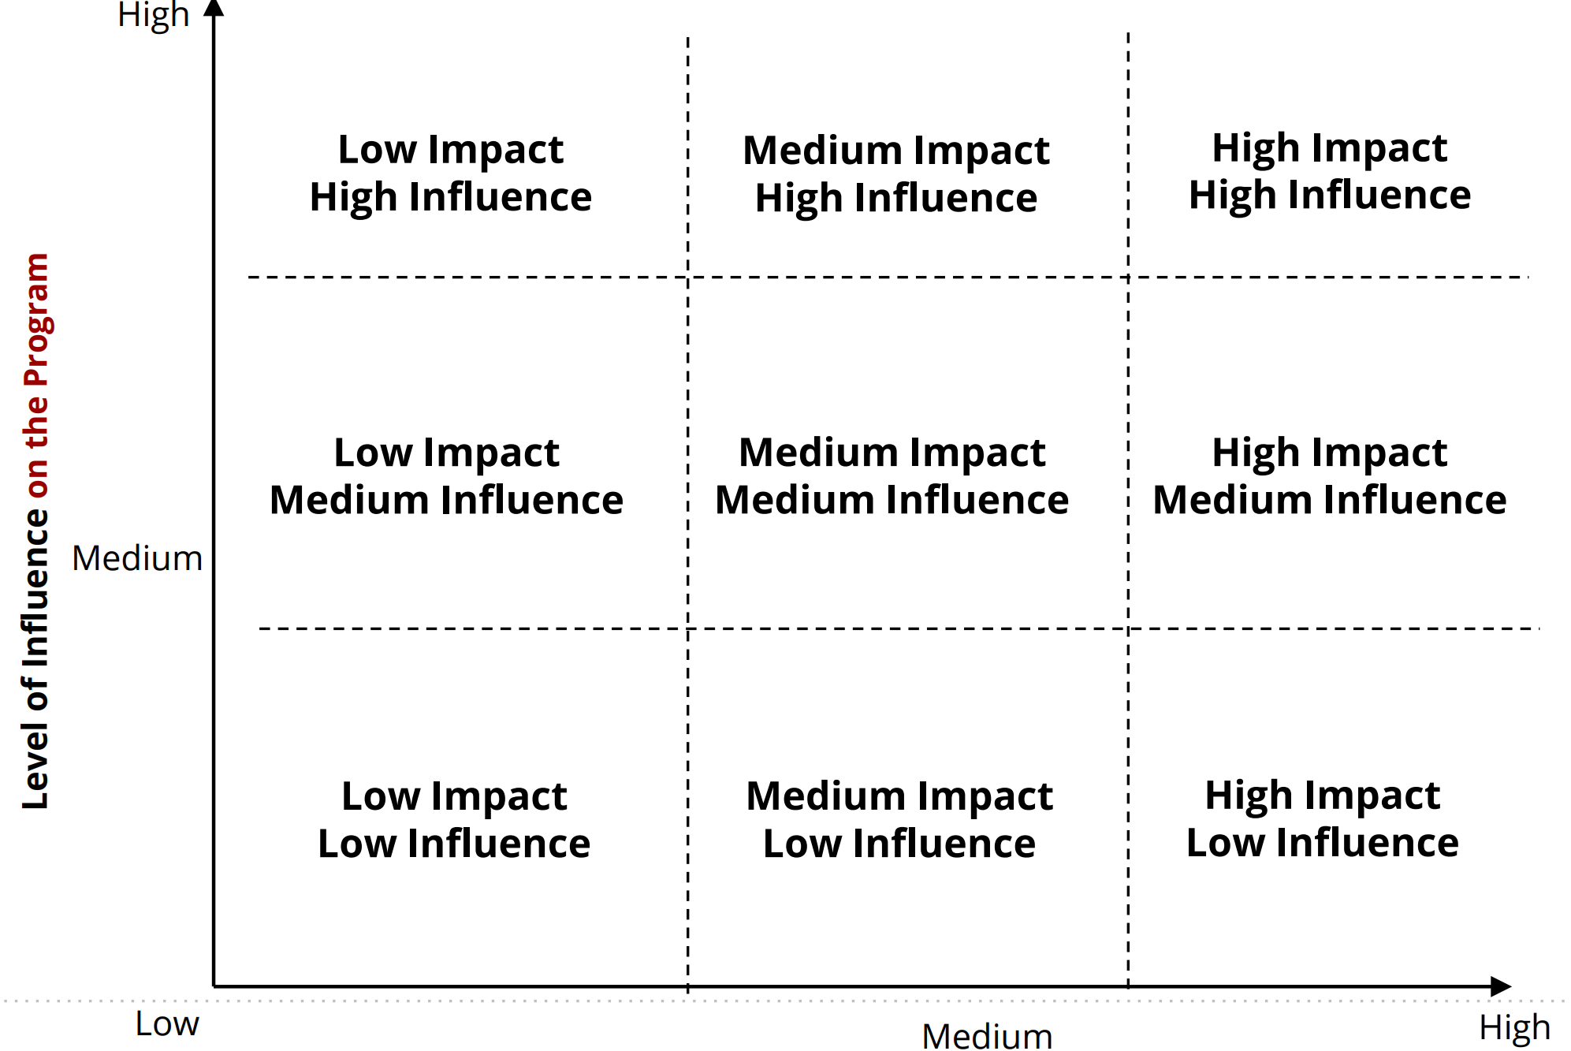
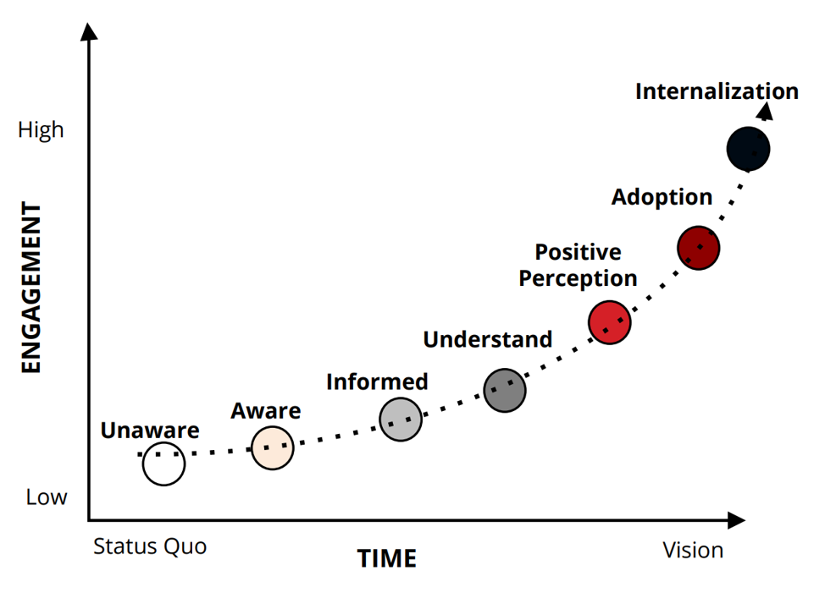
Change Management Foundations
Stakeholder’s Level of Impact by the Program
The Engagement Curve
Notes:
HINA

Slide 8
Change Management
Change Awareness
Engagement and Education
Training
Reinforcement
Be vocal about supporting WolfieONE goals
Let your team know that there is a gradual engagement curve between Awareness and Adoption
Listen and document constituents' questions and concerns
Change Champions network launch; Champions engage their colleagues
By March 2025, help engage stakeholders in your organization about the training timeline and scope. The messaging at that point will be centered around training.
Upon Go-Live: Promote training enrollment (encourage your leadership teams to carry this out) and collect feedback (encourage your teams to respond to our readiness surveys)
Notes:
HINA

Slide 9
Workstreams relevant to educational campuswide efforts:
Enterprise Resource Management: all things Accounting & Reconciliation!
Note: Student receivables and SIS are not changing (Campus Solutions).
Human Capital Management: HR processes
What’s not changing: Interfolio, Handshake, Kronos, and HealthStream
Enterprise Performance Management: Budgeting, planning and forecasting.
Technology: Integrations, Reporting (queries, out of the box, custom, FDI), Conversion.
Change Management & Project Management Office
Enterprise Data Management- net new area
Security and Controls (Depts. will need education on persona-to-role mapping)
Analytics (Fusion Data Intelligence); more broadly trained upon closer to go-live- see Appendix
Notes:
HINA

Slide 10
WolfieONE - Changes
Notes:
HINA

Slide 11
What’s Changing?
CURRENT STATE SYSTEMS/PROCESS​ | FUTURE STATE SYSTEMS/PROCESS​
Inconsistency across processes and practices​ | Standardize processes and practices (80/20)​
Oracle/PeopleSoft software for Finance | Enterprise Resource Planning (ERP) Cloud
Oracle/PeopleSoft software for Human Resources​ | Human Capital Management (HCM) Cloud​
Campus Budget Module (CBM) for Budget and Planning ​ | Enterprise Performance Management (EPM)​
SOLAR (time and attendance; employee information, NOT the student side)​ | Human Capital Management (HCM) for reporting time and attendance
Recruiting and onboarding in Taleo​ | Oracle Recruiting Cloud (HCM)​
CPR (Capital Planning, construction) | E-builder, which will integrate with EPM
Notes:
KER

Slide 12
What’s not Changing?
CURRENT STATE ​ | FUTURE STATE INTEGRATIONS​
Jaggaer (WolfMART) SUNY system-wide SaaS solution for Procurement​ | Possible retrofit for some fields with the new COA, integration with Oracle, end-user will continue to use Jaggaer in the same way​
Concur for travel & expense reimbursement ​ | End-user will continue to use Concur in the same way as in the current state but will have to know their COA Org and Fund Source. ​
Hospital - Finance (Lawson)​ | Hospital finance professionals will continue to use their current COA in Lawson​. Exception: patient refunds team in accounting, and budget officers.
Student Information Systems​ | The student records (both academic and tuition/fin aid) side of SOLAR will remain the same. Students’ employee records will exist separately from their Academic record in WolfieONE.​
Hospital usage of Kronos | Will integrate with SUNY system for payroll purposes.
Interfolio | Faculty will be hired in Interfolio and then their data will flow to WolfieONE (Core HR) for onboarding.
HealthStream | The hospital will continue to use HealthStream, and it will integrate with the Learn module of HCM.
Notes:
KER

Slide 13
Chart of Accounts (COA)
Notes:
KER

Slide 14
Terminology
Hierarchy: a structure that provides summarized nodes used to report on all the "children" that fall below it. Oracle gives the ability to rearrange the children values into alternative hierarchies that also summarize the reporting view.
The parent and child levels are part of the hierarchy for each segment in the chart of accounts.
The child represents the lowest level in the hierarchy. The child values are the values used when entering transactions.
The parent(s) represent reporting nodes that group the child values that are found below the parent in the hierarchy. Parent(s) are used for efficient reporting and queries.
Chart Segment: Every segment is a critical dimension in representing some aspect of the business – legal, financial, operational, management – “tagging” every transaction, like a hashtag or a label. The future state “golden rule” is for each segment to have a single and standard use for every segment across departments. No “co-mingling” of purposes.
Attribute: acts like a static tag of the chart segments to provide an alternative way to write reports. Example: Academic vs. Non-academic Orgs.
Chartstring: The combined segment values, in a fixed order, is called a chartstring. Every event on a transaction that has a financial impact generates accounting entries, posting it to a combination of segment values in the General Ledger. This illustrates what a chartstring looks like:
Notes:
KER

Slide 15
New Chart Segments
Entity – Major institutional operating unit (e.g., SBF, SBU).
Org – An operating area that is responsible or benefits from the specific transaction. The area must have intended permanence and must have an employee and/or a financial budget greater than $100,000.
Fund Type – A classification of the funds based on how the funds are allowed to be used.
Fund Source – A self-balancing set of accounts categorized by purpose, ownership, responsibility or restriction.
Account – Nature of the transaction (e.g., asset, liability, expense, revenue, net position).
Classification – A classification of the balance sheet, revenue or expense transaction.
Initiative – Cross-organization used segment to identify activity for organization initiatives and/or where two or more departments contribute.
Budget Year – An identification of the budget year for prior budget spending.
Future – A segment that allows for growth in the future.
Notes:
KER

Slide 16
Oracle Cloud Overview
Notes:
KER

Slide 17
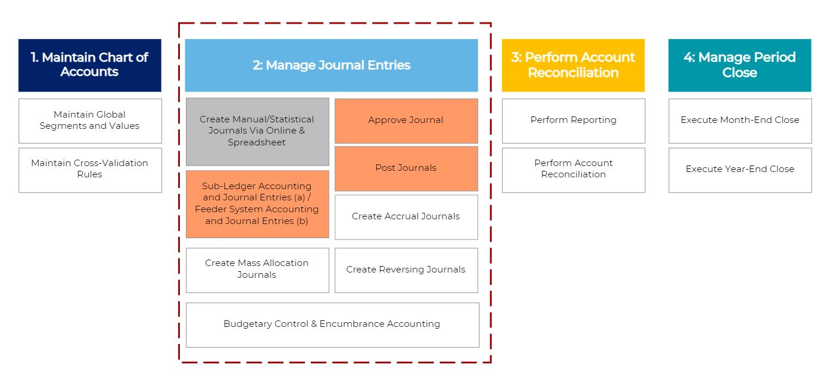
ERP General Ledger breakdown
Notes:
KER
Ker to explain dependencies and how data flows across modules.

Slide 18
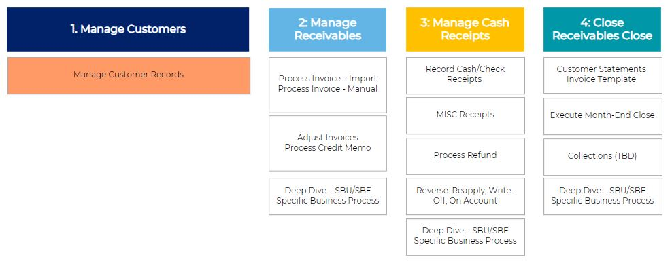
ERP Example of Receivables breakdown
Notes:
KER
Speaker: Ker (keep it high level and say let’s deep dive if we have time) The top area is the one you should look at “do I do this in the current state? If so, I am impacted”

Slide 19
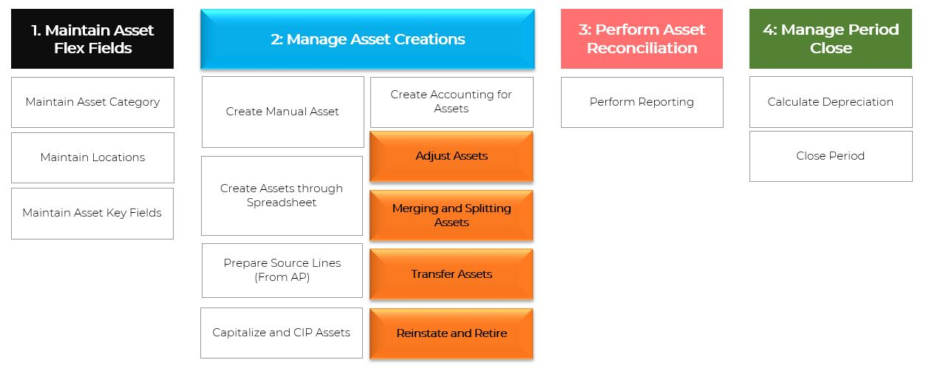
ERP Fixed Assets breakdown
Notes:
KER
Examples of assets: building, IT licenses, intellectual property and anything that was built by researchers for research use (equipment), or anything that sits in RAM in the current state.

Slide 20
ERP Cash Management breakdown
Manage Cash Management
1. Manage Bank Master Data
2: Manage Bank Account Transfer
3: Receive Bank Statements
4: Reconcile Bank Statement
Notes:
KER
Speaker of this slide to explain dependencies and how data flows across modules.

Slide 21
ERP Payables (Refunds only)
Types of refunds:
- Student
- Patient
- Department
- AR credit to an external party
Manage Payments
1. Manage Suppliers
2: Manage Period Close
3: Manage Payables Invoices
Notes:
KER
Speaker of this slide to explain dependencies and how data flows across modules.

Slide 22
EPM
Budget Formulation
Non-Personnel Expenses Entry at COA level; Revenue Entry at COA level; Strategic Planning
Driver-based Revenue Modeling; Target Setting
Benefits:
Systematized central planning and forecasting system
Real-time budget vs. actuals reporting for the academic & research enterprise
Systematized handshake between workforce planning and authorization to recruit
Scholarship Discount Model
Base / Fiscal Planning
Overhead and Fringe Cost Planning
Budget Management
Multi-year Forecasting/ Projections
Budget Adjustments (COA level)
Commitment Planning
Workforce Planning
Manage Existing Positions
Manage Vacant Positions
Create New Positions
Allocations/ Costing/ Splits
Reporting
Ad hoc Reporting (SmartView)
Narrative Reporting
Management Reporting
Executive Dashboards
Notes:
KER
Exec. Sponsors update-
This is from the Town Hall, refer to Town Hall and latest newsletter- mention that workforce planning is separate

Slide 23
Oracle HCM
Core HR
Payroll
Time & Labor
Performance
Learn
Compensation
Absence Management
Recruiting (ORC)
Journeys
HR Helpdesk
Notes:
KER
Ker “more info – breakdown in appendix

Slide 24
HCM Change Impacts
Notes:
KER

Slide 25
Known HCM change impacts to all employees:
- HCM Employee Self-service
- HCM Manager Self-service
- HCM Learn module- net new
- HCM: HR Helpdesk – net new
- ERP Departments who bill external parties will need to learn the Receivables module, and will rely less on central accounting, while moving away from QuickBooks
- Financial reporting: leveraging the new COA for queries (specific searches using the segments and values, particularly the parent nodes to see all the transactions that roll up to it)
Notes:
HINA

Slide 26
Human Capital Management Summary
The HCM changes align to the Guiding Principles, minimizing manual processes and paper forms, reducing risk or human errors and leveraging guided flows to show the user what data needs to entered, where, and by whom.
Leveraging Journeys – a NEW concept – will improve the employee experience and save time. Examples: Pre-employment check process, onboarding, or signing up for benefits (employee self service). Core HR Journeys include Voluntary Reduction in Work Schedule, Offboarding, and any type of leave, like FMLA.
New reports will be available for Managers (both ad-hoc and delivered Oracle reports for HR Administrators and Managers). All fields (including customizable) in WolfieONE are reportable.
Approvals will be in the system, for most processes, instead of offline via e-mail or paper form.
Total compensation statement (all rewards visible in one place).
The move to Standard Review Period for annual evaluations, making evaluations more consistent (instead of a rolling one-year lookback).
Removing or eliminating the need for DocuSign (leveraging Oracle functionality) for most/all (recruiting and onboarding) processes.
Notes:
Journey = list of tasks (similar to a checklist) that require the user’s completion in order to reach a goal, or business process. For example, a ‘Name Change Journey’ might include tasks such as uploading required documentation, approval from a supervisor, steps to update the name in our various systems across campus that the user accesses.

Slide 27
Human Capital Management Trends
 | Current state | Future state
Core HR | Using PeopleSoft HCM and pulling data from emails. Employee data for various entities is stored across various systems. | This is the support structure for all HCM modules and employee data. New business processes enhance the overall user experience. State (University, Hospital, LISVH) and RF employee data will be housed in one unified platform. Standard level of approvals (3) across all HR processes will reduce the time it takes to complete transactions. Multiple assignment employment model will accommodate specific scenarios for additional duties and pay elements. Accountability: better visibility into the workflow (who needs to take action). The Position Synchronization feature will allow assignment fields to be pulled directly from the setup, eliminating duplicate entry and discrepancies with external systems.
Recruiting & Onboarding | Faculty: Interfolio is utilized for recruitment; onboarding is paper based (manual entry into PeopleSoft.) Graduate Student Employees: Onboarding is via DocuSign; manual entry into PeopleSoft. Staff: Recruitment & Onboarding occur in Taleo with data integration into PeopleSoft. | Consistency of onboarding processes across Stony Brook entities and departments. Standardization of recruiting procedures for staff (excluding Faculty recruitment). Seamless recruiting and applicant tracking (instead of having items via e-mail, pdf forms, and items in Taleo or DocuSign). Having an all-in-one system (data flows from ORC to Core HR). End-to-end process in Oracle Recruiting Cloud for staff. Expediting candidates to new hires, eliminating manual entry (less risk of human error). Standardized offer letter & acceptance processes for all ensures a consistent electronic delivery and transparency. Pre-employment check process for Faculty and Staff will be delivered in a seamless manner. Ability to leverage RMI & Journeys to ensure candidates complete all their required tasks. Recruiters will no longer use the current requisition templates.
Notes:
Using Position Management at the start of the Recruiting Process and no longer using Requisition Templates.
Offers are the most important data source for candidate's new assignment.
Using Manage Job Offers screen and Pending Worker screen
Use of Manager Self-Service and Employee Self-Service; including ESS to view internal jobs.
University recruiting uses “ACE questions” in Taleo. Change and training needed to acclimate to future state: using filtering and grid view to select candidates.

Slide 28
Human Capital Management Trends
 | Current state | Future state
Analytics | Multiple sources for reports. | Leveraging system functionality with the ability to consume data from a single source of truth. It allows users to create ad-hoc reports (tailored to the user’s parameters) that can be shared and inherits security from the user role. Ability to leverage hundreds of “seeded” (out-of-the-box) reports, which can be delivered on a scheduled basis.
Employee Self-service | E-mail exchanges with HR Administrators. Manual entry of employee details, which has margin for errors. | Empowering employees to initiate changes to their personal record. Employees can own and manage their data through an intuitive interface and track the status of their requests. Employees will see their person profile, which includes their skills and qualifications. This reduces risk for the institution: eliminates the errors due to manual data entry from paper / email into the system.
Learning Management System | No unified learning platform. Departments/ VP areas are using disparate solutions, which are not connected. Manual entry for the completion of courses/ measurement is tracked on spreadsheets. | Automation of training deployment and assessments. Ability to centrally host training resources, track completion/ measurement (compliance training analytics) and view all employee training reporting in one single platform. Personalized learning recommendations based on Job Families (Example: HR or Information Technology). Flexible course structure supports various learning needs​. Allowing managers to assign training to their teams​. Social Learning through communities & discussions is a new capability.

Slide 29
Human Capital Management Trends
 | Current state | Future state
HR Helpdesk | Emails for support requests go to HR administrators through HR shared mailboxes. | Improved customer service: HR agents will handle, delegate, or escalate tickets. Auto routing of the ticket to the appropriate group and in-system ability to reassign the ticket to another agent. Employees can view the status of their tickets. Employee will be able to look for policies in knowledge management system, saving time. Based on analytics on the tickets, the project team can proactively work on improving system set-up and processes to improve the user experience.
Performance Management | Employees receive hard copies of performance documents. | Digitalization: Performance Management will be electronic and consistent for employees. Employees will be able to see their past performance documents in one central location. New ability to send performance documents through automation (or trigger the performance program manually).​ AI functionality to summarize reviews (managers will still have final authority). Check-ins, Feedback Request, Goals as expectations will be new concepts. Approval (in system) will route to HR and Employee Relations. Manager Self-Service and Employee Self-Service will be crucial to the performance and goal process.
Manager Self-service | Managers reach out to HR for support. | In-system approval workflows for all HCM modules. Empowering managers to review and take actions on their direct and indirect reports. This enables effective team management, fostering autonomy and accountability.
Compensation Administration | Requests via email or Taleo. Discretionary raises are done by distributing spreadsheets to depts. and collecting the responses, then central HR uploading to 2 payroll systems (Oracle EBS and PayServ). | Better analysis of salary surveys at the job level enables the institution to calculate the most appropriate salary for the job market. Automation of compensation rosters to perform salary increases, such as across-the-board merit increases, within WolfieONE. Discretionary raises will be done within the system without the manual intervention (creating and dispersing spreadsheets). VP Areas will no longer need to split out and send spreadsheets and then collect them for submission to HR.
Notes:
Still have to reconcile and check: ORC. Checked all the others.
Comp administration: Less manual work for HR Administrators + total comp statement; training needed on ICP, new Oracle concept.

Slide 30
Human Capital Management Trends
 | Current state | Future state
Payroll | Manual entries into PayServ, PeopleSoft HCM, and RF EBS (entry errors risk). Manual reviews and approvals. Current state nomenclature includes “earn codes” and “comp rate codes”. | Employees will enter their own bank details into WolfieONE for direct deposit. Payroll/Labor costing: splitting costs when the employee’s salary is going to be funded from different sources (Different initiatives or fund sources) RF employees do not currently have labor costing in PeopleSoft , RF employees labor distribution will be integrated into WolfieONE, improving reporting capabilities. New nomenclature and processes will require training, such as “update” vs. “correct”, and “save” vs. “submit”.
Absence Management | University: Accrual banks are manually calculated for employees who submit paper time sheets. They are calculated automatically for employees who submit their time in SOLAR. Time off requests are tracked separately from time entry. Hospital and LISVH employees- enter absences in Kronos system. | University: Absence Management is a separate functional area from Time and Labor of WolfieONE, which will pull data from Core HR and Time and Labor to calculate accruals. HR administrators will need training on entering leaves that were approved outside the system. Employees will need training on the absence attestation. Employees will be able to submit time off requests to their managers, and if approved will automatically be added to their timecards in Time and Labor. Note: Hospital and LISVH employees will enter absences in Kronos system (no change).
Time and Labor | University employees- Paper forms and SOLAR. HR administrators do manual entry. Additional pay components (e.g. overtime, compensatory pay, on call/recall, etc.) are manually reviewed and entered in external payroll systems. Hospital and LISVH employees- enter time in Kronos system. | University: this module will replace paper and SOLAR time entry. Review and approval will take place in the system before payroll processes. Managers will need training on approvals. All employees will require training on logging their time, including lost time due to absences. The policy around time entry for terminations will change: the last day of work will be the last day employees can log their time. Entering time promptly upon deadlines will impact other modules, Employee should submit time sheet on time or managers have to submit the timecard on behalf of teams. Additional pay components (overtime, meals, compensatory time) will be calculated automatically and sent to external payroll systems (EBS and Payserv). HR Administrators must review the dashboard to know the group time cards statuses, fix the errors if any. (data verification for new hire/termination/transfer cases). Hospital and LISVH employees will enter time in Kronos system (no change).
Notes:
Training for all exempt employees on absence certificate (employee self-service for their absences). NOTE: MC and UUP nonexempt employees will continue to absence report along with exempt employees. No change from the current state.
Integration with payroll processing entities (current state of PeopleSoft is not connected to RF EBS for payroll data, such as a W-4 or bank details)
RF ORACLE EBS -HCM Extract

Slide 31
Current State: a combination of emails, attachments, paper forms, and SOLAR
Manager Self-service
Future
State:

Slide 32
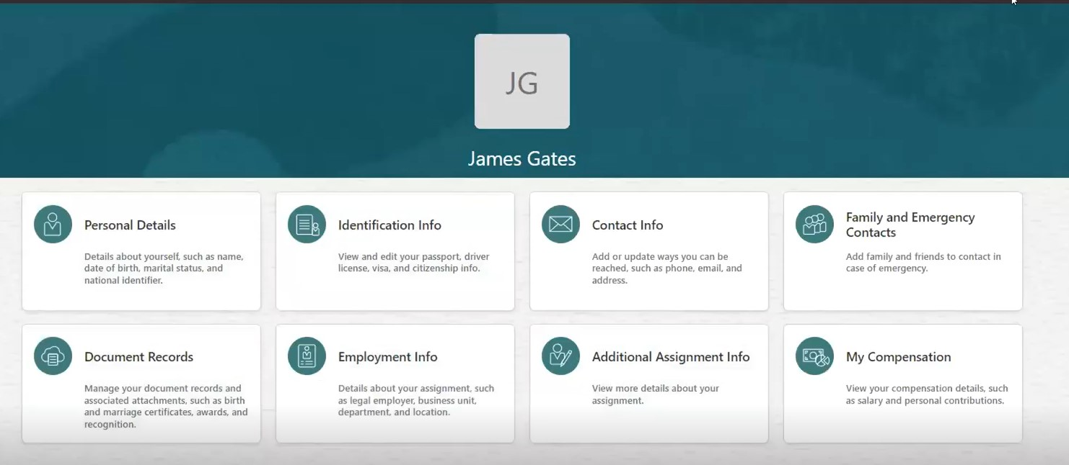
Employee Self-service Tiles

Slide 33
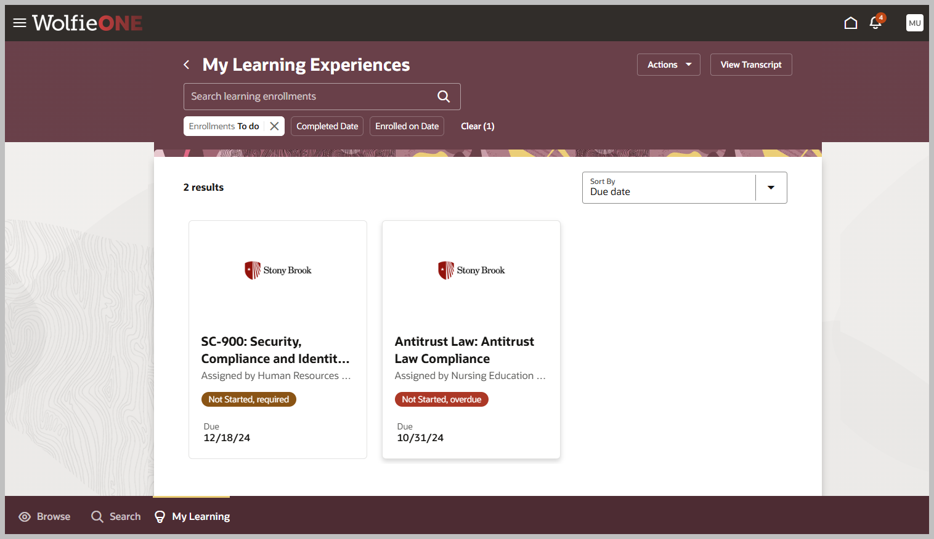
HCM Learn- Screenshot

Slide 34
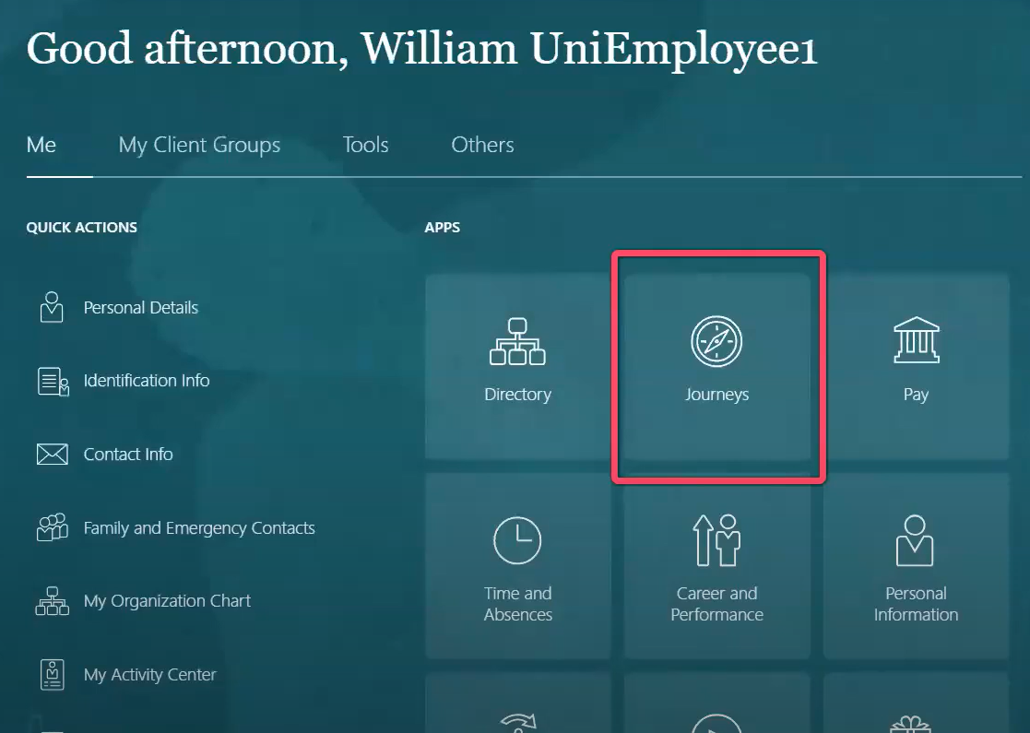
Sample Journeys – Landing Page Tiles

Slide 35
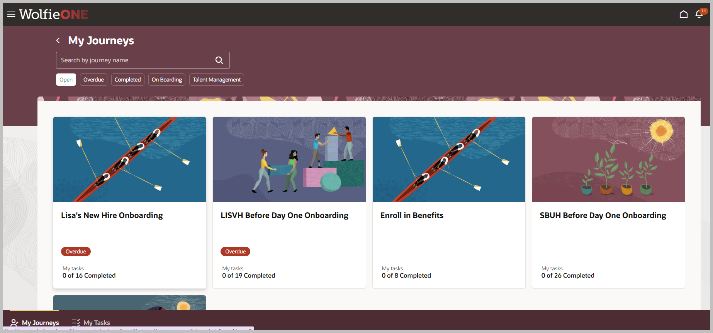
Sample Journeys- HCM Screenshot
We can develop eligibility profiles around Journeys (If I meet that criteria, then the Journey is assigned to me). The Manager can assign journeys, via Manager self-service.

Slide 36
Next Steps
Notes:
KER

Slide 37
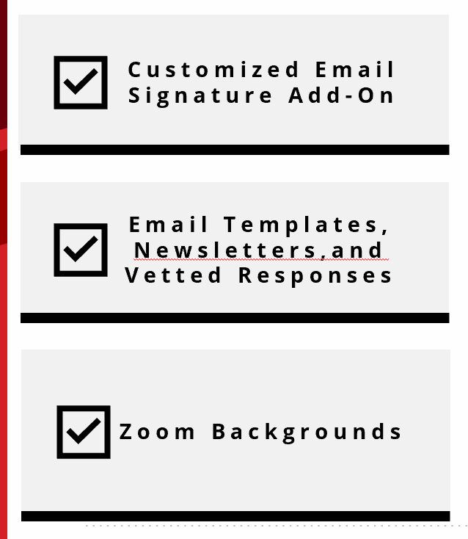
Change Champion Action Plan
Use
This
logo
Know, Share, Do | Nov 2024 – Jan 2025
By 12/02: Review the WolfieONE website in detail, including:
Nov: Which processes fall under ERP, HCM and EPM
Timeline update: Build Sprints go until Spring 2025, we will then enter Testing
Dec: Review Frequently Asked Questions (FAQs) & let us know what to add
Jan 2025: Action Plan will be released by the OCM team
Know This!
Identify peers who are “your counterparts”
Identify the department ongoing meetings at which WolfieONE can be an agenda item & ask for time during those meeting to present
January: join team meetings to deliver program updates (refer to talking points provided in this session and the OCM meeting-in-a-box)
Share This!
Copy/paste the WolfieONE logo (top right) and add to your e-mail signature, along with:
“Proud Change Champion, ask me about WolfieONE!”
Save the WolfieONE website resources to your bookmarks (print the QR code that will be provided by OCM and post it in your office!)
ASAP: Set reminders to spend just 15 min biweekly on the WolfieONE website
Dec 2024: Share the WolfieONE website, personal note from the eNewsletter (excerpt that has meaning) with select colleagues- “Did you know”?
Jan 2025: Share notable feedback and questions from colleagues with OCM
Do This!
2025 Dates are subject to change and we will keep you posted!
Notes:
KER and HINA
Hina to speak to the newsletter point (how to choose something and make it meaningful)

Slide 38
Appendix

Slide 39
OCM Contacts
Hina Kausar
Director, Office of Change Management
Hina.Kausar@stonybrook.edu
Nichole Gladky
Training Manager, Office of Change Management
Nichole.glady@stonybrook.edu
Ker Famer
OCM, Deloitte
kariley.famer@ stonybrook.edu
OR
kfamer@deloitte.com
Julian Herrero
OCM Trainer
Julian.Herrero@stonybrook.edu

Slide 40
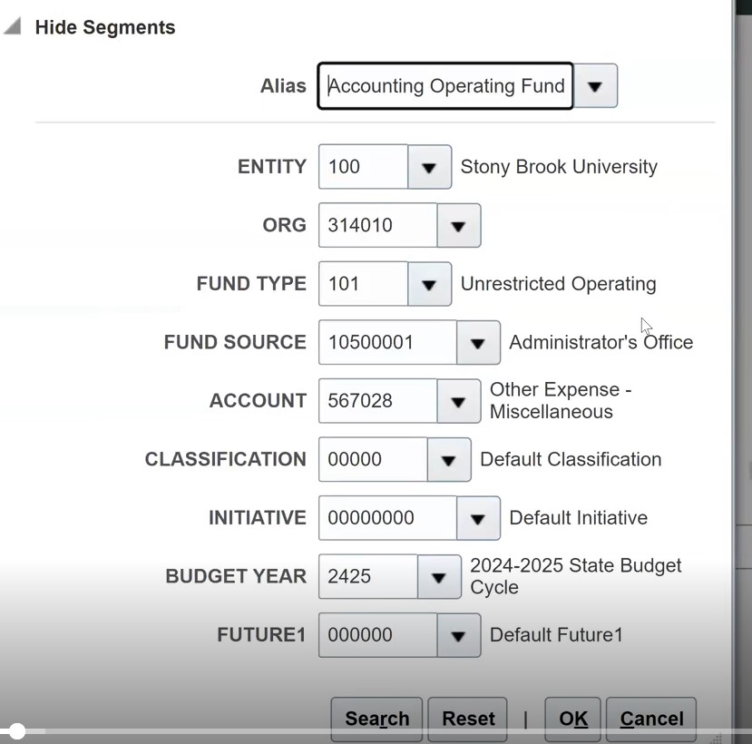
Example of COA Alias and segments on a financial transaction (drop down menu)

Slide 41
Zoom Background

Slide 42
WolfieONE Logo

Slide 43
Analytics
Fusion Data Intelligence (FDI) is Oracle’s reporting platform, comprised of several applications, such as Fusion ERP Analytics and Fusion HCM Analytics. These cutomizable tools empower all users to understand how each part of the business impacts company goals and strategy.
Gain consistent and combined data across departments with a prebuilt, single analytics data model for Oracle Cloud Application data that can also include any external data.
Get all your important KPIs and metrics all in one place to make quick decisions with a library of ready-to-use, best practice KPIs.
Predict and understand how your business processes across departments affect business outcomes with cross-subject area business views and prebuilt machine learning (ML).

