Slide 1
Change Champion Training – Part 2
December 13, 2024
Notes:
KER

Slide 2
AGENDA
Recap
Getting Started as a Champion
ERP Change Impacts
Personas
Champions’ Journey
Website Walkthrough
Elevator Pitch exercise
Next Steps

Slide 3
RECAP
Change Leader Network Training – Part 1
Notes:
HINA

Slide 4
Change Leader Network (CLN) Process
Reward & Recognize the Change Champions
Define the Roles and Responsibilities of the Change Leader Network
Follow Up with Nominated and Volunteered Candidates to Get Commitment
Ask the Managers to Nominate Candidates
Manage the Change Leader Network
Kick-off the Change Leader Network
Define the Criteria for Selection of Change Leaders
Provide an Overview to Managers of Potential Change Champions
Design Change Network Strategy
Develop Change Network Plan
We are here
Conduct training(s)
Socialize Network​
Leverage for driving change
Provide Support, as needed​
Gather feedback
Notes:
HINA

Slide 5
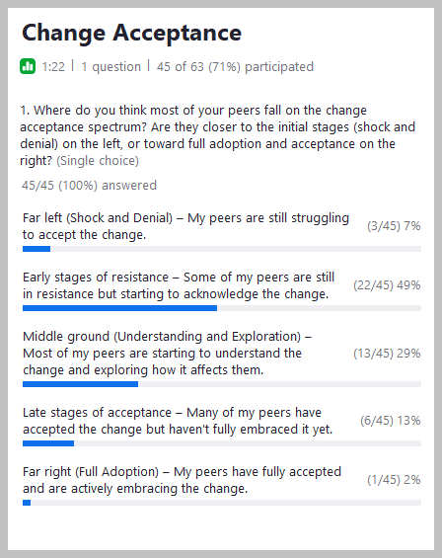
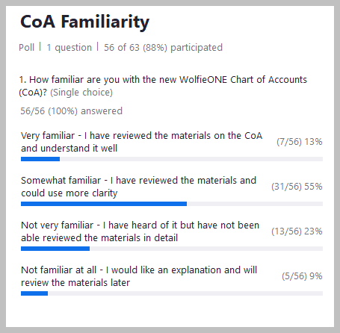
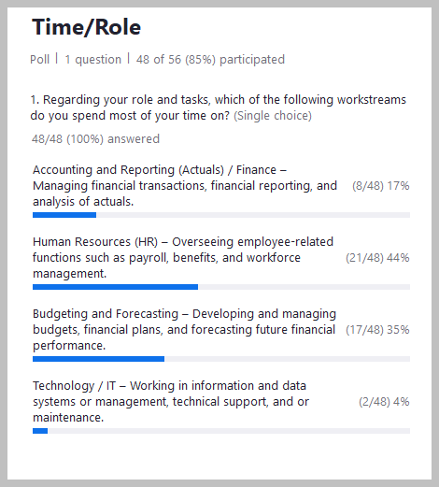
Recap
Change Management
WolfieONE – High Level Changes
Chart of Accounts (COA)
Oracle Cloud Overview
WolfieONE Modules and Processes
HCM Known Change Impacts
Poll Results from 11/14 Training Session
Notes:
HINA

Slide 6
Getting Started as a Champion
Notes:
HINA/ Turn it over to Lyle

Slide 7
Champion Role
Champion the Program
Promote our Guiding Principles
Participate
Promote yourself as a Champion
Spread awareness & key information from program to peers & community
Share the expected benefits
Stony Brook First
Transparency and Inclusion
Governance
Single Source of Truth
Optimized Operations and Processes
Transformation
Attend monthly one-hour Change Leader Network meetings
Accept invites, show up, be engaged
Attend program and/or workstream-related events and activities (webinars, roadshows, townhalls, etc.)
Notes:
Lyle

Slide 8
Champion Role
Learn and Engage
Communicate Changes
& Gather Feedback
Ease Tensions and Anxiety
Learn and understand the solution – new tools, technology, roles, behaviors needed
Participate in key implementation activities or recommend individuals to participate
Distribute communications
Help them understand the change and its benefits
Foster two-way communication
Collect grassroots concerns, questions, & feedback from peers & community, share with program team
Share ideas for strategies to best engage Stakeholders
Engage with users, group leaders and managers
Guide colleagues through the process of change (change curve)
Share ideas for strategies to best engage Stakeholders
Identify and address points of resistance
Notes:
Lyle

Slide 9
Change Framework
ADKAR: A methodology framework to achieving individual change
KNOW IT
SEE IT
TRY IT
DO IT
ADOPT IT
Promote yourself as a Champion
Spread awareness & key information from program to peers & community
Share the expected benefits
Attend monthly one-hour Change Leader Network meetings
Attend program and/or workstream-related events and activities (webinars, roadshows, townhalls, etc.)
Participate in key implementation activities such as solution demos or recommend individuals to participate
Understand the Solution yourself first and how to navigate the new system and processes
Participate in
User acceptance testing (UAT)
Train-the-trainer
End-user training
User Readiness Surveys
Support your user community at go-live as they make the transition to performing their job tasks
Point them to resources and support available
Watch for users finding workarounds
Ensure your user community is adopting the new systems, processes, tools and behaviors
Provide continued support
Be on the lookout for users reverting to old ways of working
Notes:
HINA/Lyle

Slide 10
ERP Change Impacts
Notes:
KER

Slide 11
ERP Change Impacts
It’s important to communicate that if your peers use systems that integrate with WolfieONE, such as Jaggaer and Concur, they will need an understanding of the new COA, and why. This is because the transactions must flow between systems with the accurate chartstrings. Entering the wrong information will result in having to do the work twice! The summary of big picture ERP changes, or “noteworthy mentions” is as follows:
Greater oversight, transparency and ease of tracking transactions (finding exceptions and variances), and monitoring financial performance. For example: seeing projected balances and leveraging budgetary control.
End-to-end training will be needed for transacting and on new reporting tools.
Department-level managers (and IFR managers) will need training on areas such as creating invoices and receipts (AR), queries and reports. This includes continual training on the Chart of Accounts, which users don't interact with on a regular basis in the current state in PeopleSoft.
Reporting (for the processes in scope) will be generated from a single source of truth through various tools, such as BI Publisher, Oracle Transactional Business Intelligence (OTBI), and FDI (Fusion Data Intelligence). ERP supports the Chart of Accounts benefits, such as multiple levels of hierarchies in each segment. Hierarchies provide summaries that can be queried and reported.
Subledger accounting is a new mindset, in which transactions roll up to the General Ledger from the subledgers, and the Accounting team can drill down from the General Ledger to the subledger for transaction details.
The monthly period close process will be net new to Stony Brook, as well as using the 13th period (instead of the current adjust period and closing periods). Closing the period monthly is a leading practice and enables the institution to have monthly financial statements.
With new integrations, WolfieONE will become the source of truth for SBU and SBF financial data, which means the information within the system can be “consumed” in a more up-to-date manner and with less of a lag in data feeds from other sources.
Notes:
KER

Slide 12
ERP Change Impacts
 | Future State
Cash Management | All workflows will be new. Oracle allows for Automated reconciliation, NET NEW processes. ONLY impacts central accounting.
Fixed Assets | Ability to upload or manually add, manage, depreciate, and track fixed assets in WolfieONE. Net new processes will require training. Gaining visibility into assets value/depreciation/financial details, automation of data capture and reporting.
Payables (AP) | Leveraging functionality for patient refunds, student refunds, travel reimbursements and department refunds (departments refunding a customer that they billed through AR). Moving to Oracle Cloud. 1099/1042 Reporting and Withholding will be new for SBF and will require training.
Receivables (AR) | New processes will require training: invoicing external clients, balance reconciliation (not done in the current state), creating invoices in ERP, creating and applying receipts, using infolets and watchlists. Decentralized AR model distributes the workload across department (for external invoices) and improves accountability while requiring more unit level training Increased visibility into external billings and better financial reporting Data natively integrated with the General Ledger, enabling the tracking of external receivables, aligning with our Optimized Operations & Processes principle.
General Ledger (GL) | Net new processes will require training. Create, post, review and query journal entries in Oracle Cloud. Entering and posting transactions on time or more frequently is key to having accurate financial statements. The importance of entering/updating data in a timely manner is a key training piece. New concept: which Business Unit in which to transact and which values to select. Increased coordination and standardized maintenance with HR is paramount, because the org structures are shared.
Notes:
KER/HINA

Slide 13
Personas
Notes:
HINA

Slide 14
Personas
As a Change Champion, it is important for you to know and communicate to your peers:
- Personas can have multiple Oracle Cloud custom roles (your department will be helping DoIT, HR, BFP&A and the Office of the Controller in mapping the right roles to the personas)
- Training (learning pathways) is aligned with personas
/per·so·na/ A fictional character designed to represent a segment of stakeholders who might interact with a process, service or product in a similar way.
Examples of HCM Personas
Manager
Employee
Manage a team
Onboarding support
Generate reports
Evaluate performance
Assign learning content
Fill vacancies
PAIN POINTS: manual paper forms, having to ask DoIT or HR Administrators to perform a transaction for their direct reports
View Personal and Employment information
Complete required training for compliance
Update personal records
View pay slips
Understand performance metrics and access their yearly review
Complete I-9
PAIN POINTS: Having to ask DoIT or their Managers to change their personal data; Manual paper forms (timekeeping, leave requests, disjointed onboarding tasks)
Notes:
HINA

Slide 15
Personas
/per·so·na/ A fictional character designed to represent a segment of stakeholders who might interact with a process, service or product in a similar way.
General Ledger Manager
General Ledger Accountant
Billing Clerk
Review requests for changes to COA ​
Specify cross validation rules or security rules ​
Review/approve journal entries
Approve adjustments and close the period​
Supervise GL Accountants
Oversee changes to policies and to GASB, FASB accounting standards
Business process documentation steward
For SBF: manage external audits and multiple state tax filings
Responsible for 1042 and 1099 reporting
Develop leaders within the team
PAIN POINTS: system limitations, reconciliation issues, process control issues, manual processes, missed month end close deadlines​, spending too much time on finding documentation.
Create Manual journals & Recurring journals​
Upload third party journals
Reconcile unposted entries
Review and create month-end reports​
Process month-end and year-end adjustments​
Perform period-end activities​
Resolve discrepancies or irregularities in records
Account reconciliation within the system and the boundary systems
Ensure financial data is recorded in the appropriate period (accruals, deferrals, prepaids)
Review and post journals
Review/Approve reimbursements (Concur)
PAIN POINTS: Delays in sub-ledger closing and reconciliations​
Spending too much time on finding documentation and chasing people for approvals/sign-offs
Limitations with current system, inconsistent tools
Too many types of journals from various sources
Lack of governance of the chart of accounts.
High volume of cost transfers to balance budgets
Professionals with understanding of billing processes and experience using billing software
Responsible for generation and delivery of invoices to customer, managing the related corrections and reconciling customer payments and invoices
the review of revocable permit contracts received from AP office
Running reports
PAIN POINTS: Not receiving communication on delayed billings and appropriate approvals on correction entries such as credits and adjustments
Lack of time and resources to work with customer to build relationship and collect payments
Incorrect or outdated billing rates for Service Center.
Notes:
HINA

Slide 16
Champion’s Journey
Notes:
KER

Slide 17
Change Champion Journey
Change Champions will be asked to act as representatives from their departments or units and as partners of the WolfieONE program, and align their WolfieONE expertise with modules/processes, rather than departments.
1. Tell the Change Story (Spring 2025)- not the data
Help peers understand what’s “in it for them”. Work with OCM to construct a shared “Change Story” at your next leadership meeting, in your upcoming departmental newsletter, or via existing communication channels
Be realistic and recognize that change is challenging, “status quo bias” is expected
2. Provide Honest Feedback (April 2025)
Leverage your subject matter expertise and familiarity with your peers and counterparts to help us shape communications, engagement, and training
Provide input and feedback on program communications
3. Build Trust (ongoing)
Engage others with whom you have influence, build support (informal networks matter!)
Become a trusted communicator by taking on the responsibility of keeping your department or group “in the know”
5. Monitor Resistance & Empower End Users
Serve as an informal “go-to” point of contact for two-way communications
Escalate obstacles that are preventing your group or department from being ready for change as you empower them to be confident that they are prepared for go-live
4. Champion Change (ongoing)
Continue vocal support as go-live approaches
Use existing forums and channels to build awareness
Reinforce the focus on the overall vision (the bigger picture)
Put up go-live posters in your office / workspace with the QR code that will link to formal training (closer to go-live)
Use WolfieONE Zoom backgrounds
Go Live
6. Support Adoption
Partner with project leaders to drive adoption and connect end users to support channels
Set an automatic email reply to reinforce key messages (e.g., “Need help registering for courses this month? Reach out to ocm@stonybrook.edu”)

Slide 18
Change Champion Journey
Learn about new functionality and processes. Then, share the benefits using OCM materials to educate peers.​
Design
Build
Test
Train
NOW: Schedule time in your “local” meeting, OR offer to host one.
Explain, through formal and informal channels, that while “some modules are in Build, some elements are still in Design”- big picture decisions that will impact configuration. EPM started later, therefore, the timeline is behind ERP and HCM.
Jan 2025:
HR Changes meeting-in-a-box from OCM team, with a focus on Employee Self Service (ESS) and some modules such as Learn (LMS), Oracle Recruiting Cloud (ORC) will enhance the employee experience.
Feb 2025: Manager Self Service (MSS),
meeting-in-a-box, and how some modules such as performance management and time and labor will be leveraged by and enhance the manager experience.
March 2025:
New COA: with a focus on educating targeted audiences on segment definition, single use for each segment and sharing some relevant examples.
April 2025: Champions to support the OCM team in assessing organizational readiness.
Goal: Drive an increase in the number of respondents to the Mid-Point Change Readiness Survey (as compared to the Baseline Readiness Survey - before the launch of the Champion Network)
OCM team delivers a new action plan for the next 3 months.
2025: Change Champions will gain access to Oracle environment to start familiarizing themselves with the interface and prepare to participate in testing.
Notes:
HINA

Slide 19
WolfieONE Champion Toolkit
Notes:
HINA

Slide 20
Toolkit Introduction
The Change Leader Toolkit is a collection of resources, to refer for your own knowledge and to help inform your peers. This is linked here WolfieONE Champion Website and meant to serve as a one-stop-shop for our Seawolves’ network of Power Users & Change Champions.
This Toolkit is… | This Toolkit is not…
…a repository that is updated regularly View the “as of” dates of change impacts for a timestamp of the last update. | Meant to holistically inform Change Champions. Educational meetings and two-way communication are also critical to this network.
…a tool for Change Champions to: Stay informed Access key resources Understand their roles and responsibilities Knowing which process areas to focus on (Finance vs. HR vs. Tech) | …perfect or holistic, and we love feedback! Please reach out to Hina Kausar /OCM Mailbox [ocm@stonybrook.edu] with any content you’d like to see added or any gaps you notice need filled that could be helpful.
Notes:
HINA

Slide 21
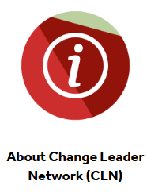
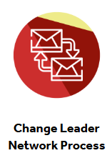
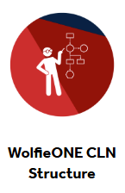
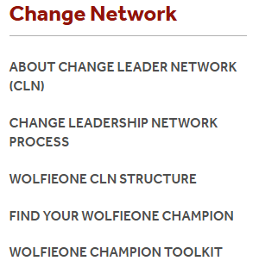
Champion Website
WolfieONE Champion Website

Slide 22
Next Steps
Review the Champion Toolkit - WolfieONE Champion Website
Identify audiences you would like to share WolfieONE information with. Check with other Champions to ensure there is no duplication of effort. Check the Events Calendar - https://docs.google.com/spreadsheets/d/e/2PACX-1vRfh3gdssAkKI1wsKb3Yh6eymQI_akkGQIcxxoct6l3473czJrNmJmixn-fPbT0FOQ2b94pFuFqi4pJ/pubhtml
Request time on meetings you can join and add to the Events Calendar using this link - https://docs.google.com/spreadsheets/d/1mFG-WrT48Kv5aorcH1-l67ptlqDkQpP0UKiOjXU0_JE/edit?gid=2023941331#gid=2023941331
Review material to present (will be shared in the Champion Toolkit)
Jan 2025 – ESS
Feb 2025 – MSS
March 2025 – COA
The expectations are uniform from all Champions (managers, direct reports)
Communicate with us – we love to hear from our Champions

Slide 23
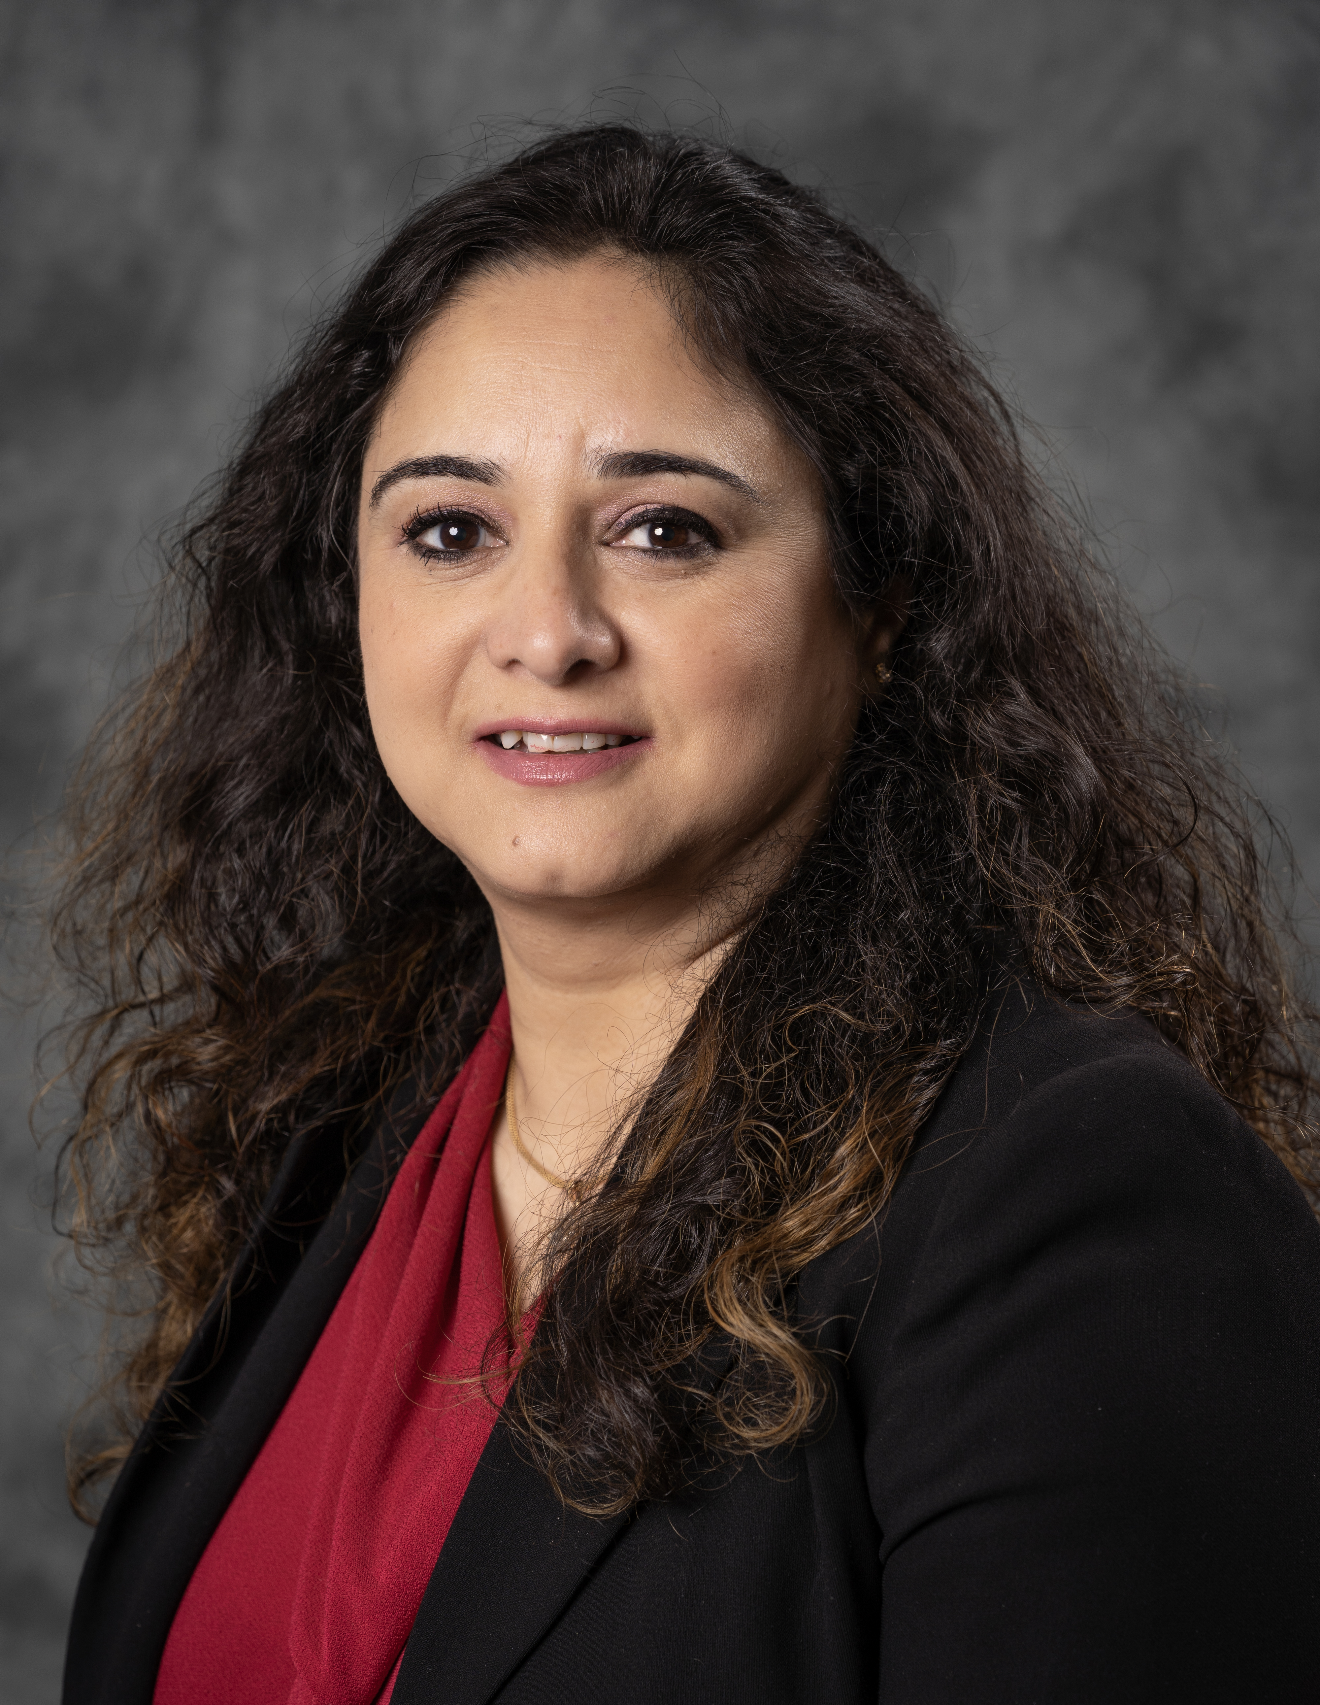
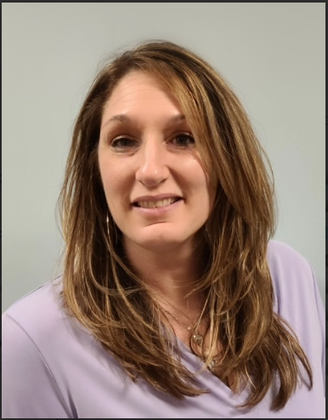
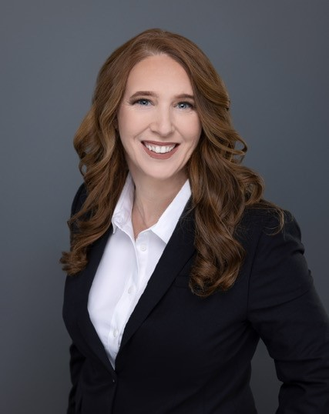
OCM Team
Hina Kausar
Director, Office of Change Management
Hina.Kausar@stonybrook.edu
Trainer
Nichole Gladky
Training Manager
Nichole.glady@stonybrook.edu
Julian Herrero
OCM Trainer
Julian.Herrero@stonybrook.edu
Devon Kellaher
Communications OCM
Devon.Kellaher@stonybrook.edu
Ker Famer
OCM, Deloitte
kariley.famer@ stonybrook.edu
OR
kfamer@deloitte.com
TBD

Slide 24
Appendix

Slide 25
What’s Changing?
CURRENT STATE SYSTEMS/PROCESS​ | FUTURE STATE SYSTEMS/PROCESS​
Inconsistency across processes and practices​; Data inconsistency | Standardize processes and practices, ensure data consistency
Oracle/PeopleSoft for Finance | Enterprise Resource Planning (ERP) Cloud
Oracle/PeopleSoft for Human Resources​ (SOLAR & “Admin”) | Human Capital Management (HCM) Cloud​
Campus Budget Module (CBM) for Budget and Planning ​ | Enterprise Performance Management (EPM)​
SOLAR (time and attendance; employee information, NOT the student side)​ | Human Capital Management (HCM) for reporting time and attendance and personal records
Recruiting and onboarding in Taleo​ | Oracle Recruiting Cloud (HCM)​
CPR (Capital Planning, construction) | E-builder, which will integrate with EPM
Notes:
KER

Slide 26
New Chart Segments
Entity – Major institutional operating unit (e.g. SBF, SBU).
Org – An operating area that is responsible or benefits from the specific transaction. The area must have intended permanence and must have an employee and/or a financial budget greater than $100,000.
Fund Type – A classification of the funds based on how the funds are allowed to be used.
Fund Source – A self-balancing set of accounts categorized by purpose, ownership, responsibility or restriction.
Account – Nature of the transaction (e.g. asset, liability, expense, revenue, net position).
Classification – A classification of the balance sheet, revenue or expense transaction.
Initiative – Cross-organization used segment to identify activity for organization initiatives and/or where two or more departments contribute.
Budget Year – An identification of the budget year for prior budget spending.
Future – A segment that allows for growth in the future.

Slide 27
Networking Activity
Notes:
KER – EXPLAIN ACTIVITY
NICHOLE – BREAKOUT GROUPS

Slide 28
Elevator Pitch
In Breakouts (groups of 5), WolfieONE Champions are given 10 minutes to network. Create an Elevator pitch for your peers that illustrates a business challenge and how WolfieONE solves it.
Prompt: Problem statement (current state, choose ERP or HCM for your pod, and then a process area, for example “HR: too many levels of approval or too many approvers for recruiting”
Craft Your Elevator Pitch
Pair up at your table or take turns as a table group and practice your pitch!
Come back together and share pitches with the full group.
Steps | Prompt | Hints
Opening | Start with an engaging opening to capture attention | Example: “How might we fill vacancies faster and attract the best talent?”
Problem Statement | Clearly define a problem that your department faces that Oracle Cloud, our new system, addresses. | What is a constant point of frustration of current systems? How does it impact the people using those systems? Review earlier slides in your handout
Benefits | Highlight the system, the benefits to your department, and how it solves the problem. (What is on their minds, tailor the next step to how the WolfieONE benefits speaks to their needs) | Think back to your table talk conversations What are people excited about with the move to Oracle Cloud? You may refer to materials that emailed or on the WolfieONE website
Call to Action | End with a clear call to action or next step for your peers | Example: “I’m going to educate my peers by hosting a coffee chat with a focus on this one process area and invite a SME to help me present.”

