Slide 1
COSA
2021-2022 End-Year Report
President’s Council of Student Advisors
May 6, 2022
Notes:
Jade

Slide 2
Acknowledgements
President Maurie McInnis
Chief Deputy Judy Greiman
Rachel Cavanagh
Ashley Porcello
Ahmed Belazi
Dr. Marisa Bisiani
Dr. Rick Gatteau
Undergraduate Student Government | Counseling and Psychological Services | Center for Prevention and Outreach | Student Health, Wellness & Prevention Services
Educational Opportunity Program | Title IX | Student Engagement | Student Support Team
Notes:
Jade

Slide 3
Recap of Project
Notes:
Jade

Slide 4
Research Topic:
Student Mental Health During COVID-19
Notes:
Anthony

Slide 5
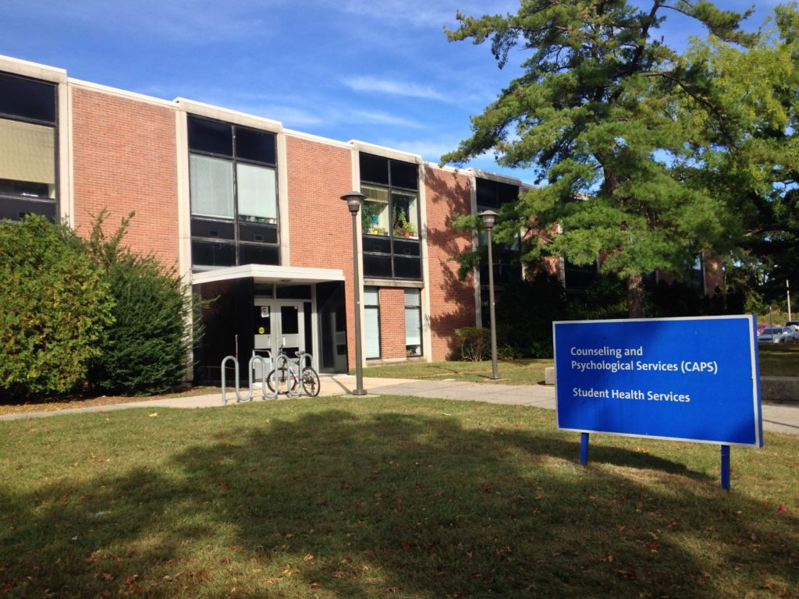
Purpose
Our project is aimed towards understanding students and the Stony Brook communities status towards their mental health, especially in recovery of a global pandemic. In understanding their current mental health we can then develop with the assistance of faculty, staff and other forms of outreach to students to utilize current services and introduce recommendations as needed to further strengthen services provided.
How can we empower students to communicate health related needs, utilize resources, and self-advocate in various academic and employment situations to remain engaged and become successful in academic and other endeavors?
Notes:
Jade

Slide 6
Year- Long Survey Participation
Current Students (entered prior to Spring 2022) response rate of 958 participants
New Students (entered Spring 2022) response rate of 93 participants
Academic Affairs response rate of 163 participants
Student Affairs response rate of 186 participants
Interviews with departments and student organizations
Small-scale focus group
Notes:
Jade

Slide 7
Literature Review
Mobile Apps and University measurements of Happiness/Mental Health
College student engagement with mental health apps: analysis of barriers to sustained use. Journal of American College Health, 1–7. https://doi.org/10.1080/07448481.2020.1825225
Uptake and effectiveness of a self-guided mobile app platform for college student mental health. Internet Interventions : the Application of Information Technology in Mental and Behavioural Health, 27, 100493–100493. https://doi.org/10.1016/j.invent.2021.100493
Peer to Peer Support Implementation
Structural relationships between students’ social support and self-esteem, depression, and happiness. Social Behavior and Personality, 44(11), 1761–1774. https://doi.org/10.2224/sbp.2016.44.11.1761
A school-based program to prevent depressive symptoms and strengthen well-being among pre-vocational students (Happy Lessons): protocol for a cluster randomized controlled trial and implementation study. BMC Public Health, 22(1), 139–139. https://doi.org/10.1186/s12889-021-12321-3
Universities Implementing Resource Courses
Evaluation of a credit-bearing online administered happiness course on undergraduates’ mental well-being during the COVID-19 pandemic. PloS One, 17(2), e0263514–e0263514. https://doi.org/10.1371/journal.pone.0263514
Notes:
Anthony

Slide 8
Factors Playing a Role in Happiness
The Relationships Among Gratitude, Self-esteem, Social Support and Life Satisfaction Among Undergraduate Students. Journal of Happiness Studies, 16(2), 477–489. https://doi.org/10.1007/s10902-014-9519-2
Psychological Support For Students
Promoting Well-Being in School-Based Mentoring Through Basic Psychological Needs Support: Does It Really Count? Journal of Happiness Studies, 15(2), 407–424. https://doi.org/10.1007/s10902-013-9428-9
Peer support in mental health services. Current Opinion in Psychiatry, 27(4), 276–281. https://doi.org/10.1097/YCO.0000000000000074
Using Mental Health Services to Advertise to Potential Students
Advertising Anxiety Resources to Increase Enrollment and Support Student Mental Health. College and University, 96(1), 16–29.
Student Studies
Barriers of mental health treatment utilization among first-year college students: First cross-national results from the WHO World Mental Health International College Student Initiative. International Journal of Methods in Psychiatric Research, 28(2), e1782–n/a. https://doi.org/10.1002/mpr.1782
Trends in college student mental health and help-seeking by race/ethnicity: Findings from the national healthy minds study, 2013–2021. Journal of Affective Disorders, 306, 138–147. https://doi.org/10.1016/j.jad.2022.03.038
Notes:
Anthony

Slide 9
Survey Results

Slide 10
Mid-Year Recap
Four surveys:
Academic Affairs
Student Affairs
New Students
Current Students

Slide 11
Academic Affairs (Mid-Year Survey)
Notes:
Princila, Allana, Anthony

Slide 12
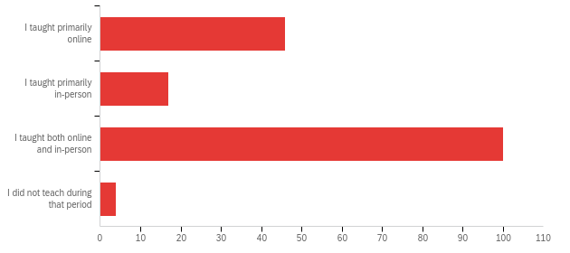
Q12 - If applicable, please indicate your primary mode of teaching between March 2020 - January 2022
46
17
100
4

Slide 13
Q1 - What immediate changes did you see in your students when switching to a digital platform?
I was pleasantly surprised by the degree of engagement that at least some students evidenced in zoom classes--even in a large (60 student) undergraduate class, there were a number of students who participated regularly.
Many students seemed quite stressed and also overwhelmed by the course load
Students seemed to appreciate the flexibility of asynchronous online courses. Synchronous online courses are much more difficult. Students mostly leave their cameras off and are reluctant to interact.
A split between engaged students and distanced, "invisible" students.
Students conveyed a different mood -- more glum and resigned. Less enthusiasm and very little social interaction
They were understandably very very stressed. They found it hard to focus on assignments. They didn't seem to process and retain information and ideas as well as they did when learning in the classroom. Many fell behind. One benefit was students who probably would have been too shy to speak up in person, were vocal in that format. I loved it and learned from it.
In March, there was a shared sense of community, doing what was needed to come together and see each other through the rest of the semester. In subsequent semesters, it seemed students (and my) level of resilience had decreased the longer the pandemic raged on with no solutions in sight. This past semester (fall '21) was the worst because it was expected to proceed "business as usual" but delta (and then omicron) raging meant that many students needed grace and flexibility in a number of ways that it felt faculty were not allowed to provide. Morale was at its lowest this past semester.

Slide 14
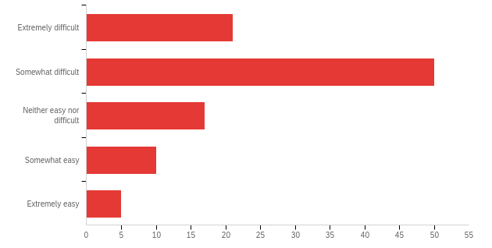
Q2 - How has online learning affected the ease with which you form relationships with your students?
21
50
17
10
5

Slide 15
Q3 - Please elaborate further on the effect online learning had on your relationships with your students?
I found it very subjective. There were times when students wanted to have in person classes so that they interact with peers and teacher. For me it was better online than face to face classes because of masks, which are very important, and frustrating that we cannot see the faces.
Since I required one-on-one meetings on Zoom for my WRT 102 students, I did not have that much difficulty to maintain relationship with many of them. But again, virtual meetings are never like in-person meetings.
It is much more difficult to engage with students and form meaningful relationships in a fully online format.
Because we are not face to face, developing rapport and a relationship is challenging. Albeit students are very connected to online relationships via social media platforms, the teacher student relationship is unique, and to develop this through learning platforms and email takes an effort.
In my recent in-person lecture course last fall, I had students regularly come up to me after class to share their thoughts on the readings or the lectures. The online mode, however, does bring out a group of students who otherwise would never participate in class.
Not even the very focussed students find it easy to reach out for help, or come to zoom office hours. There is a real loss when a student can't just come up to talk after class.

Slide 16
Q4 - What steps did you take, if any, to engage with your students in the virtual setting?
Putting students into breakout rooms and visiting each room seemed to work well. Ironically, I found it easier to do small group activities in zoom than in person.
I used the Discussion Board feature in Blackboard extensively for classwork. In addition, I had a "Water Cooler" forum in Blackboard designed to let students connect with me and each other and to foster a sense of community
Scheduled synchronous lecture, regular announcements, discussion boards regarding the course outside of what is required and graded, office hours.
One of the most important steps was to require that students keep their cameras on. Calling on students, requiring reading response questions and exercises, using breakout rooms all helped students become more engaged. Asking students in my Postwar Japan class to present their favorite popular culture film clip or anime game generated a lot of enthusiasm and good discussion.
Our classes are heavily experiential, so finding modes of making something work in-person to online has been a welcome transition. More involvement in the Chat, using polling in Zoom, more one-on-one meetings with students, playing music at the beginning of class and during breaks, starting class with small-talk before beginning, and assuring students that empathy and flexibility are keystones of the course, and that being exemplified by me throughout teaching.

Slide 17
Q5 - What is your biggest challenge in assisting students in a virtual/hybrid setting?
Conducting exams.
Students didn't engage in discussions very much. I had to invest a lot of effort for following up on students who were disconnected. I didn't teach hybrid classes.
Setting boundaries and expectations. Online learning has led to a lot more email interactions. Students seem to expect nearly instantaneous responses, even on weekends. This is not reasonable.
Keeping the distanced students engaged. Women in particular tend to talk less. Also, in history courses, the students are not reading as carefully as before since they do not print out the materials and have a hard time shifting.
Getting them engaged with the material and with one another.
The myriad distractions that are out of my control on the student end of a screen. Keeping people interested/engaged for 3 hours is tough too. Time management can be challenging, as it always takes longer to do something in a virtual setting.
At first the tech issues were a challenge and learning to be creative but now CELT and our technology department has offered education sessions to help faculty master technology

Slide 18
Q6 - What issues are your students coming to you about in regards to online learning?
The real challenges were caused by the pandemic and aggravated by online learning and vice versa. Issues of health were prominent.
Students approaching me with issues related to online classes are mostly seeking extensions on assignment due dates.
The stress of a full day of online classes, depression, family, work and others responsibilities that conflict with coursework.
I am now teaching in person, so students are not coming to me about online learning. In 2020-2021, they had technological problems, or their home situations made study difficult.
Difficulty paying attention, not having quiet space, not having reliable internet.
Communicating with other students.
Some students love online. Most students have shared with me they did not like online learning and had a much more difficult time with course content when we were virtual.
No laptop or microphones
Most of them seem to be okay with it, even though they aren't interacting nearly as much.
Falling behind, struggling with finding community
Feeling uncomfortable asking questions online, losing interpersonal relationships

Slide 19
Q7 - What recommendations would you provide to improve online teaching?
Some provisions to target to stop any cheating during exams.
I think we should keep onsite education as a primary mode.
Most large classes should be taught asynchronously if possible. It is more work for the instructor and TAs, but the educational outcomes seem much better.
Different modes of communication with the students. Discussion boards to ask questions, periodically offering synchronous lectures if it's an asynchronous course, and posting announcements frequently to check in with students.
I have no recommendations. In person teaching is altogether a superior form of teaching. THAT could be improved in various ways, depending on the discipline, the physical setting, and the user friendliness of the technology IN THE PHYSICAL CLASSROOM.
Figure out how to do less of it; encourage people to keep screens on; find ways for students to work effectively in small groups online.
Flexible deadlines and attendance policies, as well as more one-on-one engagement with students.
Set ground/class rules to improve participation and be interactive
Further tools to provide detailed scientific online exercises. At the moment I get by bootstrapping the Blackboard quiz system, but this is not ideal. So many tools exist for humanities and social science discussion, but very little specifically tailored for lab style exercises.
Notes:
Sophia

Slide 20
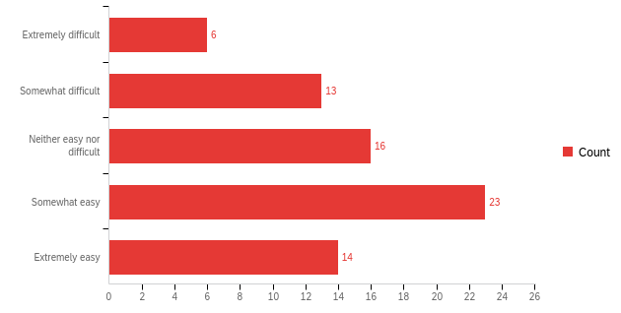
Q8 - How has in-person learning affected the ease with which you form relationships with your students?
Notes:
Sabriya

Slide 21
Q9 - Please elaborate further on the effect in-person learning has had with your relationships with students during COVID?
In-person interactions seem important, help develop connections outside of strict question-answer, vastly speed up iteration on problems.
I've always found it easier to connect with students and have engaging interactions and learning experiences
During onsite lab and simulation students need to wear masks, communication is so difficult. Being in a classroom with a mask on is difficult, you can not see facial expressions
We were all so happy to be in a classroom in the fall--I think it helped us all feel like we were in it together. It was harder to learn student names because of masking, but I eventually got there.
I'm teaching a 60 person class in a 60 person room, which makes me (and no doubt some of the students) a bit uneasy. Also, it is difficult to recognize masked students.
Clearly, not being able to engage face-to-face negatively affects the ability to establish a lasting impression. I don't remember students that I've had in virtual classes, whereas students from regular classes generally remain familiar to me long after.
Notes:
Sabriya

Slide 22
Q10 - What difficulties, if any, did you face while teaching?
Interactions are more limited - facial expressions are lost, ability to lean in close to see what a student is doing etc is imparied.
Masked teaching is not effective. I wish there was a way to mitigate the effects of mask, which we can't get rid of.
Easier in person. Harder online.
Keeping lectures interesting. Getting students to engage deeply with the reading.
Initially, teaching through a mask was challenging. Getting students to keep their masks over their noses is sometimes difficult.
in person - mask, tone, hearing, excitement, happiness not all easily portrayed
My only concern is my own personal health safety. I have an underlying health issue that could kill me if I got this virus, I am not kidding. This virus has one focus: to reproduce and consume its host. I feel terrified that the university might not have adequate health protections in place if it relaxes protocols in any way. If the university does relax protocols, then I will likely have to resign.
Accommodating those who got COVID and can't come to class
Notes:
Sabriya

Slide 23
Q11 - What solutions, if any, did you apply to overcome these difficulties?
Post pre-recorded videos posted online for those staying home
Stronger mask policy.
I would occasionally mention in class that I thought it was important that students obey mask mandates fully, including wearing their masks OVER their noses, not just over their mouths, and there would be a brief improvement, followed by the students returning to their old habits. (Still much better than if they hadn't been wearing masks at all)
I sought helpful instructional materials in regard to online teaching/assessment, and increased my students awareness of university-sponsored mental health resources - especially the Red Book, and the SBU Student Support Team.
I have had many one on one discussions with students to let them vent.
i dont know, but i think introducing asynchronous learning elements could help students prepare. its frustrating when you put forth effort and the graduate students don't utilize the resources you shared or developed.
I cancelled assignments mid-semester to accommodate student energies.
I had to find imaginative ways to adapt activities and assignments, for instance by substituting group presentations with individual slides + notes and then organizing and supervising peer assessment among students.
Fall 2021 was the first time I taught live since COVID and I did not realize until near the end of the course that students were doing less well than in the past. In the future, I will give additional quizzes.
Notes:
Sabriya

Slide 24
Q12 - What issues are your students coming to you about in regards to learning during COVID?
Students have been more focused on and aware of the disparities in health and living status. This has been an uncomfortable, depressing, angry making and eye-opening experience for many students.
Family difficulties, commuting difficulties, financial difficulties, scheduling difficulties.
Mental health issues, anxiety.
Some felt overwhelmed with assignments in other major classes. Some spoke of financial aid and number of credits needed to receive aid. Some concerned about safety and sick classmates
They all want lots of extensions and concessions made. There were too many concessions offered in April and Fall of 2020. They want to push those boundaries instead of being responsible for poor time management. Lack of support from Student Support. Classrooms are not clean, classrooms are too small with too many students on top of one another in desks.
They've been coming to me with difficulties related to they themselves missing class due to COVID or COVID exposure, and/or family members' difficulties due to COVID infections.
Some students are suffering from severe depression and anxiety. Some students have additional responsibilities at home as the result of family illness or death.
Notes:
Sabriya

Slide 25
Q13 - What recommendations would you provide to improve in-person learning during this time?
Allow students breaks and as faculty also need to take frequent breaks.
Our students need financial, psychological, and technological help! I know it's hard for the university to provide all their needs. But it has to at least recognize them. The instructions regarding testing, quarantining, contact tracing are confusing. they need to be clarified.
Provide more flexibility to students and faculty in terms of employing a hybrid approach where students can choose to follow some coursework online if they prefer and faculty can teach from home if they are quarantined.
I would like to see the students getting more emotional and mental support.
Notes:
Sabriya

Slide 26
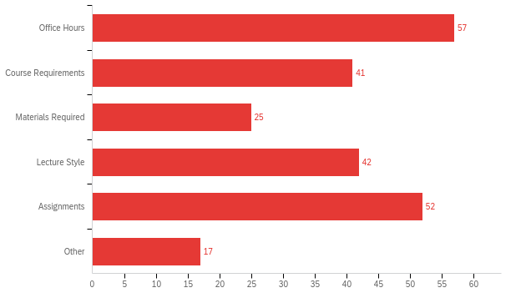
Q14 - What changes have you made to your curriculum to adjust during COVID?
Notes:
Sabriya

Slide 27
Office Hours: Course Requirements: Materials Required: Lecture Style: Assignments: Other:
I offered office hours via Zoom. I met in groups and individually; I offered later office hours than I would have if I were still on campus at that hour of the evening.
I have removed high-stakes mid-term exams from my courses. This reduces the very real problem of cheating in online exams and also reduces pressure on students. I've replaced the exams with weekly reading quizzes and post-lecture assessments.
Used platforms where students can see how to solve a question, and can input answers there. I also used a lot more digital material, and platforms that would grade in real time, so they could figure out their mistakes. I also asked them to do more stuff with data using Excel
I try to frame my teaching in very concise and digestible ways now, rather than more expansive, historical or philosophical connections.
I tried to incorporate different types of assignments to cater to different learning styles. I made use of short video intros, voicethread assignments, class work on Google docs, group and pair work during break out rooms.
None. My style is the same. I know my field of expertise. I actively listen to students. I am kind (while setting expectations for adequate completion of the course).
Notes:
Sabriya

Slide 28
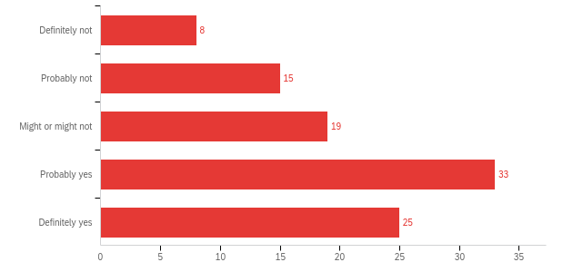
Q15 - Do you believe that the University is concerned about their staff's welfare?
Notes:
Jade

Slide 29
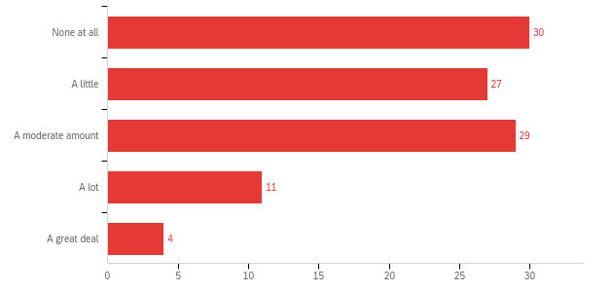
Q16 - How much did COVID affect your physical wellness?
Notes:
Jade

Slide 30
Q17 - Please elaborate further on how COVID affected your physical health.
Stress increased inflammation and decreased sleep, which led to challenging headaches, body strain, and long-term concentration.
Stress levels through the roof; meeting demands outside of teaching for the school led to insomnia; not making a living wage but giving SBU 100% and giving my students 150% = stress, worry, so-so dietary decisions and digestive issues
I could not exercise as regularly, and I found staring at the screen so many hours to be exhausting, and to cause headaches and backaches.
Affecting mental state which makes it more difficult to get motivated to exercise.
It has affected my mental/emotional state. Fortunately, it has not directly impacted my physical health as of this particular moment in time.
Notes:
Jade

Slide 31
Q18 - How were you able to maintain your physical health?
Physical activity, such as hiking and running were key to keeping my mental balance and physical fitness. Eating healthy, fresh produce and whole grains.
I struggled with this!! Gained weight... feel weaker.... starting back to gym now, buit hard to ex with mask on!
I follow all protocols. I maintain social distancing. I wear a mask - even if I'm outdoors but sense that there are too many people, too close together. I have been fully vaxxed and boosted (only 1 booster, so far).
Due to increased needs for child care, I was not able to best maintain my typical physical health.
Barely have managed. i would say it plummeted, and was not maintained. my telomeres have all but disappeared
Vaccinations, mask wearing, and regular exercise.
Lessened time in public and while on campus maintained distance from students as much as possible.
Notes:
Jade

Slide 32
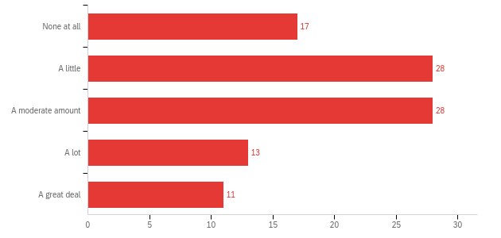
Q19 - How much did COVID affect your mental health?
Notes:
Jade

Slide 33
Q20 - Please elaborate further on how COVID affected your mental health.
I feel isolated myself. I feel like administration is putting profit and student feelings above student safety and community safety. I am often extremely frustrated by the lack of communication from administration, and also with their seeming disregard for the systemic nature of this global pandemic. I honestly don't want to teach some days.
Reduced social interactions with friends, family, and students is depressing. Lack of vaccinations in much of general public is maddening and disheartening.
There has been a lot of stress and anxiety, in general, about the state of the nation and the world, and about when it is all going to end.
Needed to take a day off here or there but if you called in sick had to go through the whole covid protocol - mental health days would be option for sick day - I wasn't going to use a vacation day
We were asked to do a lot to make Stony Brook run and it was very very taxing on us; plus everything else that everyone has faced; plus we are in a highly politicized environment.
Greater stress related to the health of unvaccinated young children and my ability to juggle things when those children are quarantined at home without normal childcare.
Notes:
Jade

Slide 34
Q21 - How did you maintain your mental health?
In summer, time outdoors is very helpful. In winter, I am finding the early dark interacts badly with the isolation. I do not feel I am maintaining, so much as declining.
Regular check ins with family and friends.
Socialize, exercise and walk outside.
Physical activity, such as hiking and running were key to keeping my mental balance and physical fitness.
I didn’t. I’m trying to regain it. Sadly, it means drawing boundaries from Stony Brook.
Maintaining contact with family and friends through social media and safe outdoor gatherings.
Notes:
Jade

Slide 35
Q22 - Are there different resources that University Administration could provide to improve mental/physical health for its staff?
Seem to care about staff. In general the impression is that they care more about how things look to the public and to students. I get it--students are why we are all here. But don't make staff feel like they are expendable for students. Also, don't let some wacky antimasking group protest on campus, especially if they tweet about carrying guns while doing it. And help staff buy appropriate masks if you aren't going to supply them.
There are university chaplains available to support EAP wellness initiatives. Explore use of spiritual coaches, wellness coaches online apps offering mental, emotional and spiritual wellness tools. Expand and or partner with business in Long Island / NYC if not already done offering discounts, resources to staff on an assortment of areas that will cover a wide range of employee needs ( housing, financial planning, vacations, spas, dinning, etc). Establish team challenges for wellbeing offer prizes incentives, set up well being lounges spaces for staff to drop in and get centered. Offer healthy food options, pop up markets on west campus for staff to be able to grab healthy items before heading home.
They could act like they care
Please be concerned about mission/workload creep. We do receive a lot of words of appreciation and support for the whiplash of learning new technologies constantly (a new LMS coming next year--yay!), but we are constantly being asked to do more.
SASC but for faculty. Better pay to reduce financial anxiety. Investing in real filtration systems in our classrooms. Increased time off for days when our childcare is disrupted due to school closings and quarantined. Better family leave.
Notes:
Jade

Slide 36
Student Affairs (Mid-Year Survey)
Notes:
Tobi

Slide 37
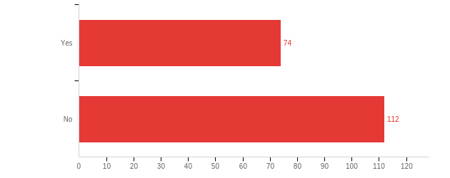
Does your office provide direct support to students who need help or are in crisis?
Notes:
Ignacia

Slide 38
Q1 - What are the major issues students are coming into your office with?
Needing accommodations for classroom/dorms due to disability related reasons
Academic related, such as: unable to get into the right classes and finalize a semester schedule, academic standing concerns such as probation or suspension, indecision about choice of major, concerns about grades, etc.
Mentoring, counseling, advising, tutoring mental health & physical health
They are concerned about the cost of college and are more likely to overload on courses, even if they are unlikely to do well, so that they do not need to extend their time to graduation. Mental health concerns that impact their academics. Issues with time management and independence
Students are not usually in crisis, but they come with ideas for student events related to diversity awareness topics. Mostly they want to process social-political events happening around them, or that they have experienced, like home insecurity, police brutality, black lives matter, a faculty member that behaved inappropriately, personal financial hardship, cultural clashes with family or peers, etc. Also, to discuss policies they think may be unfair or marginalizing.
Lack of feeling supported by faculty as they navigate their own mental health with meeting classroom expectations during COVID. General mental health and coping skills management of stress and anxiety while working through COVID.
Notes:
Ignacia

Slide 39
Q1 - What are the major issues students are coming into your office with?
Struggling with adjusting to college expectations, struggling with gaps in course knowledge or preparedness, struggling with the stress and anxiety of all of the above, struggling to decide on a major and career path, struggling to meet personal and family expectations, struggling to fund the cost of their degree, struggling with personal motivation
Students often seek out LGBTQ* Services to learn more about LGBTQ* identities in the development of their own identities. Additionally, students accessing LGBTQ* Services are often struggling with mental health that is related to how they are treated in the world (or on-campus) in their identities. Many students are experiencing multiple pressures due to other identities (race, religion, disability, etc.) and the interactions. Students also access LGBTQ* Services when they are struggling with paying for tuition, housing, etc. as well as when they are seeking out resources for medical transition.
Funding crisis, academic challenges, mentor/mentee relationship issues & personal/family issues impacting academic pursuits
COVID related issues (ie: needing online classes, infection, loss of loved one related to COVID, support related due to poor academic performance because of COVID), students struggling academically due to mental health issues, students desiring flexibility in classes (online, evening classes).
Academic advising - registration, planning, graduation progress, academic support, academic petitions, etc. For the following question - students come to our office at all phases of crisis.
Notes:
Ignacia

Slide 40
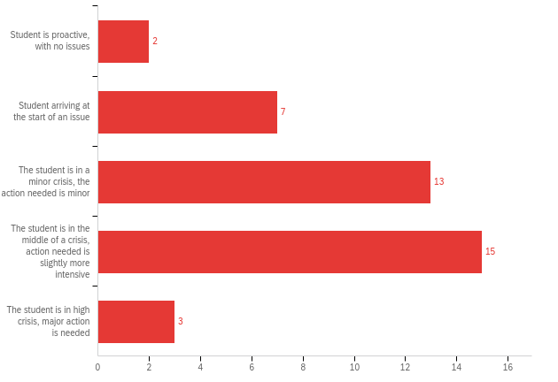
Q2 - At what phase of crisis are students usually arriving to your office?
Notes:
Ignacia

Slide 41
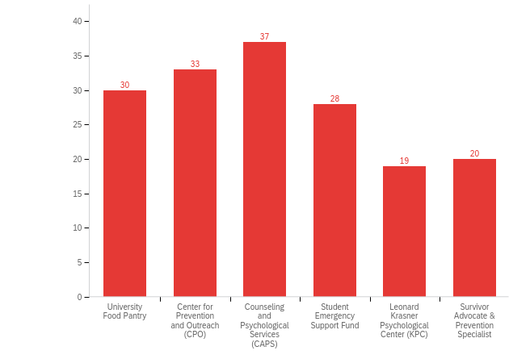
Q4 - When meeting with students are they aware of these other services offered
Notes:
Ignacia

Slide 42
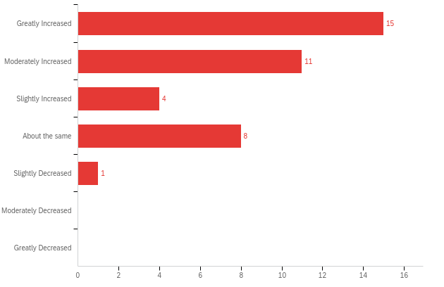
Q5 - How has COVID affected your caseload?
Notes:
Ignacia

Slide 43
Q6 - How does you and/or your staff deal with diversity requests from students?
We have the staffing for diversity requests but not enough staff to deal with demand, programming and educational efforts
By noting them in the intake/ waitlist form and trying to match students based on their requests
We usually want to discuss further in person with the zoom option if needed to make sure that we understand what the student needs and to connect them to the appropriate resources
We have a few staff members trained in diversity, equity, and inclusion support and services. They provide coaching and support to students and work to address needs when resources are available.
Talk to the students find out what their needs are, connect them to resources or talk within to see what we can do to help the request.
I utilize my department network to ensure that even if I'm not the best person to provide support to a student, it is my responsibility to make sure they have someone they can connect with.
As members of the Student Support Team, we respect each student’s unique background and cultural traditions and aim to foster a sense of belonging and dignity as we discuss their particular situation. It is rare that students have made diversity requests.
Notes:
Ignacia

Slide 44
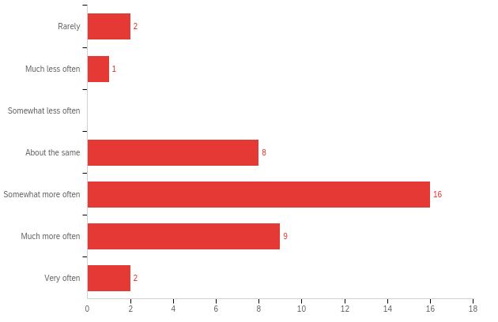
Q7 - How has the frequency of referring students to other departments/outside resources changed during COVID?
Notes:
Ignacia

Slide 45
New Students (Final Survey)
Notes:
jade

Slide 46
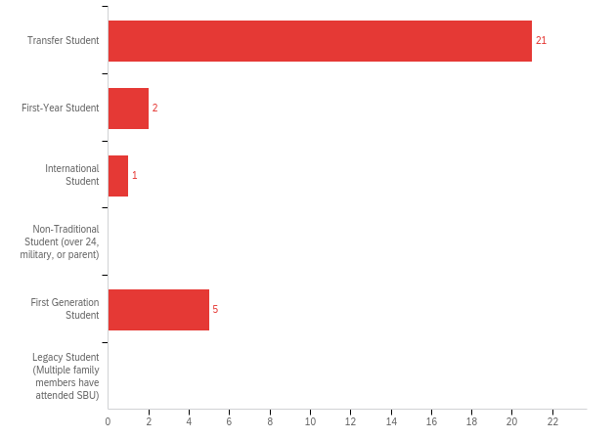
Q1 - Which Student Population did you belong to when you entered the University? Select all that may apply.

Slide 47
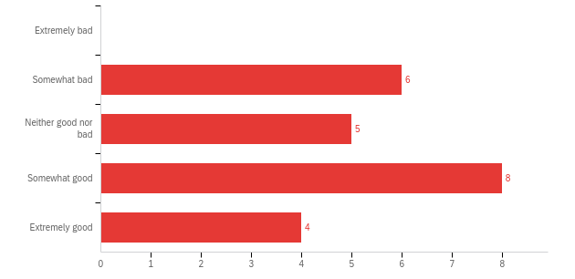
Q2 - How do you feel about the University after your first semester?

Slide 48
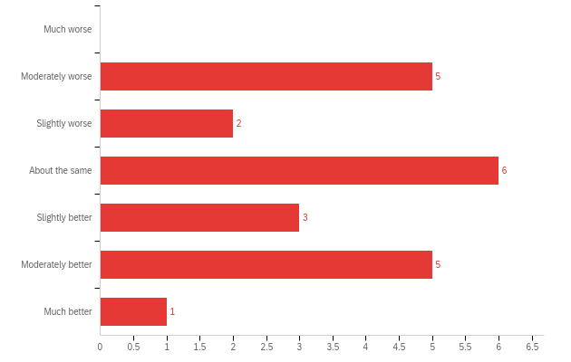
Q3 - Has your satisfaction/feeling changed from when you first began the semester?

Slide 49
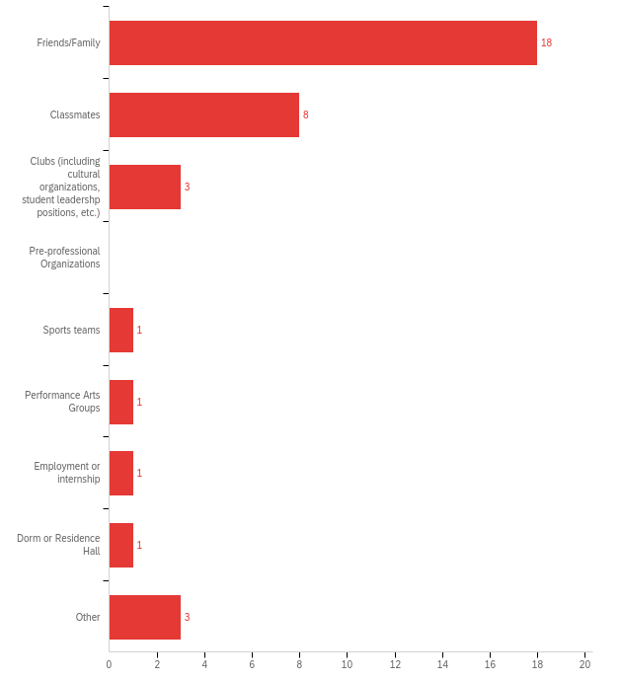
Q4 - Where did you find the most support from during the semester?
Notes:
Comfort levels being overall at a high fo

Slide 50
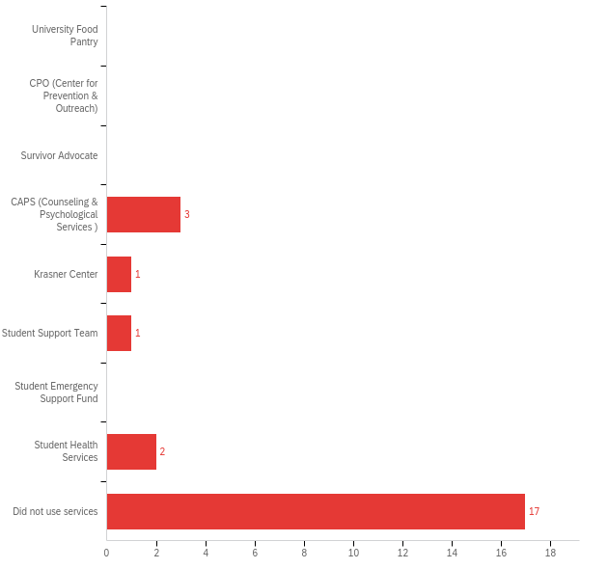
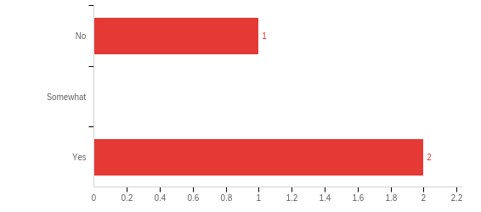
Q5 - Have you used any of these services during your first semester?
Q5.1 - Did your use of the service match your expectations of it?

Slide 51
Q5.2 - What suggestions do you have to improve the student experience of services such as the Food Pantry and CAPS?
My interactions with CAPS was that little of the effort was aimed at trying to find solutions to students problems. My experience largely made me feel as thought the service would be more aptly named "Liability (and cost) Mitigation Triage Service". As soon as I indicated I had good insurance, they immediately steered me to an off campus 3rd party provider. Additionally, the 24 hr call service left me on hold for over an hour after hearing I wasn't an immediate danger to myself or others which is a laughably low bar. I ended up hanging up and never hearing anything in terms of follow up pertaining to that call.

Slide 52
Q5.3 - If you have not used any services, why not? Is there anything you would change about this service that would make you more likely to utilize it?
I am a commuter student and these services are more geared towards campus resident students in terms of locations, operating hours, and availability.
I didn't use CAPS, because we had to do the consultation online. I like doing therapy in person because it’s more discrete and I don't like having my family hearing conversations with a therapist.
Hard and confusing to access

Slide 53
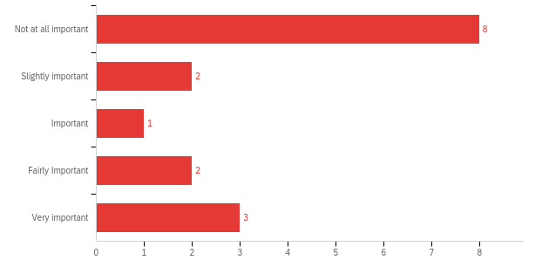
Q6 - Do you feel that your major promotes mental health practices as being important?

Slide 54
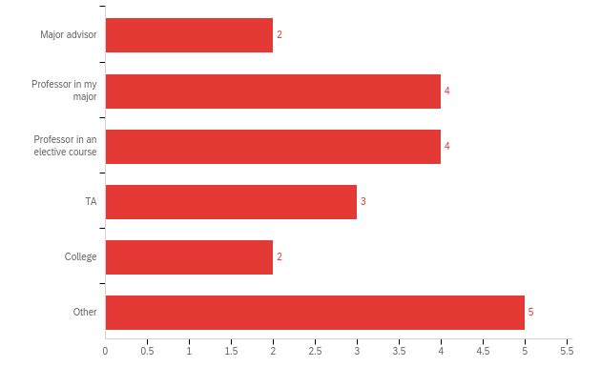
Q7 - Select any of the following who you feel best supported/promoted your mental health:
Q7.1 - Would you like to further elaborate on your experiences with those that supported/promoted your mental health?
Attending office hours and speaking with an advisor have been extremely helpful in keeping me sane during my first semester at Stony Brook. I was able to establish a that one-to-one connection.
Helped by reaching out and giving me extensions on work

Slide 55
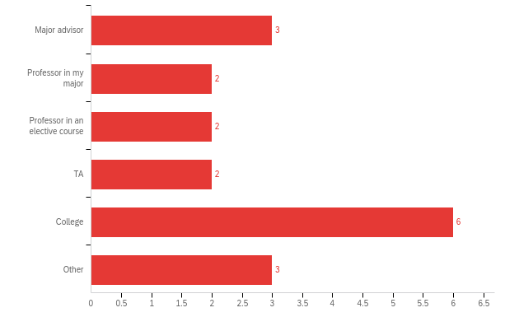
Q7.2 - Select any of the following who you feel did not support/promoted your mental health?
Q7.2.1 - Would you like to further elaborate on your experiences with those that did not supported/promoted your mental health?
Constant assignments, no time to complete them, burn out, mandatory attendance (hard on overwhelming days)

Slide 56
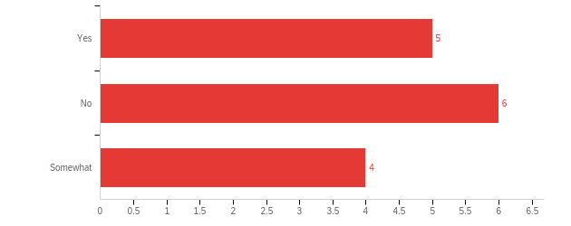
Q8 - Would you say that the advertisement of mental health services on campus is accurate to your experience of these services?

Slide 57
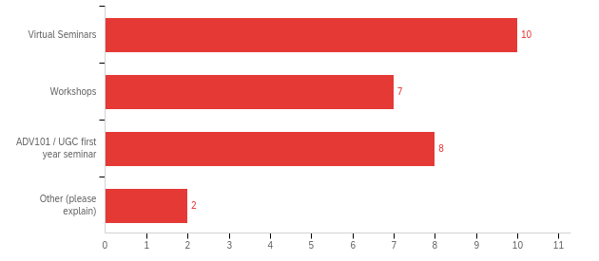
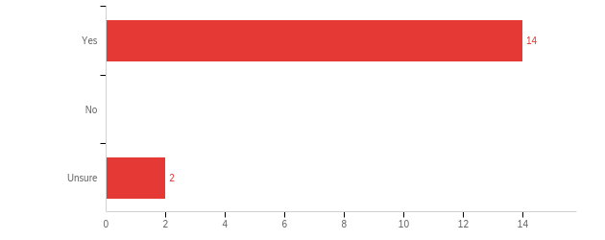
Q9 - Should the University introduce mental health services during Orientation?
Q9.1 - If so, in what format?
Other:
Mention what resources are available during orientation.

Slide 58
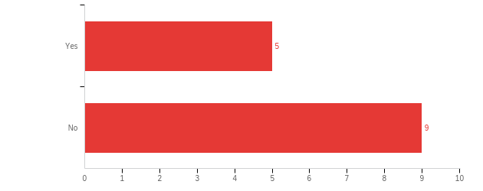
Q10 - Are there any mental health services not already provided by the University that would you like to see?
Actual availability to speak to someone without having to be put on hold indefinitely or wait several days for a phone call only to be told you will be called back with a referral off campus.
Virtual and online counseling. PTSD counseling for veterans such as myself.

Slide 59
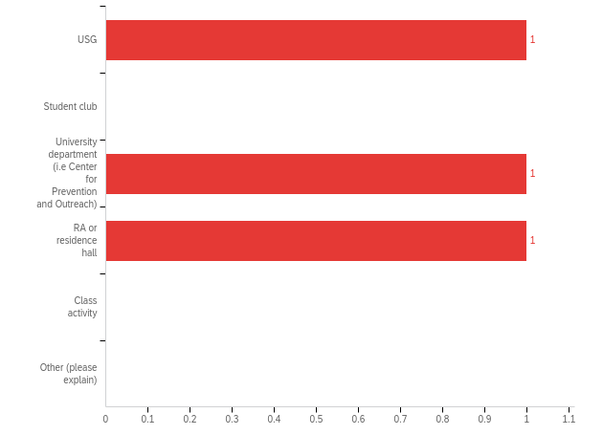
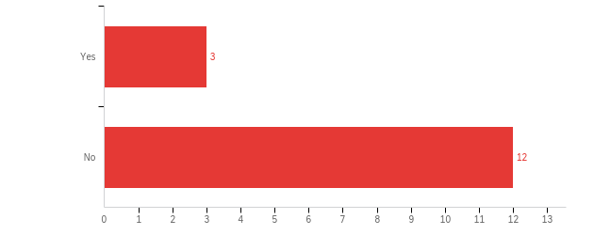
Q11 - Have you attended any events or student programming related to mental health? (I.e hosted by USG, CPO, an RA, etc)
Q11.1 - Which department or student-led organization hosted the event?

Slide 60
Q12 - Is there any mental health programming that you would like to see from a University or student resource? (Outside of a specialized department such as Counseling and Psychological Services or Center for Prevention and Outreach)
CBT as well as massage therapy would be a start.
Veterans Student Organization
Time management and how to balance work and life

Slide 61
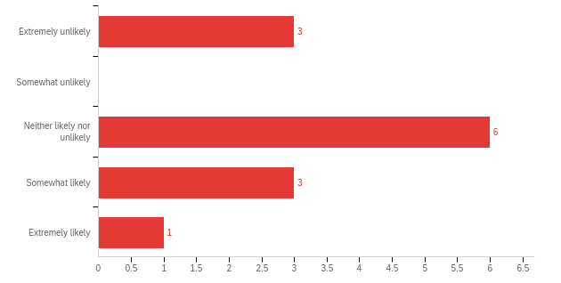
Q13 - In response to previous survey results Counseling and Psychological Services has introduced a Student Experience and Satisfaction coordinator who will "listens to and responds to your compliments and concerns related to CAPS. The coordinator addresses your questions, openly hears your feedback, and helps resolve problems about accessing care, your recent visit, or the care received by our counseling team." How likely would to share your concerns about your interactions with CAPS with the student coordinator?
Limited time in my schedule to talk to deaf ears and/or people with their hands tied too tight by bureaucracy to actually have the autonomy to make appreciable change (and hopefully thereby improvement).

Slide 62
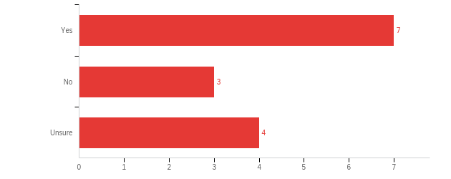
Q14 - If introduced; would you like to see crisis messaging (i.e a pop-up advertising emergency services) prior to entering the CAPS/CPO/ student health website?

Slide 63
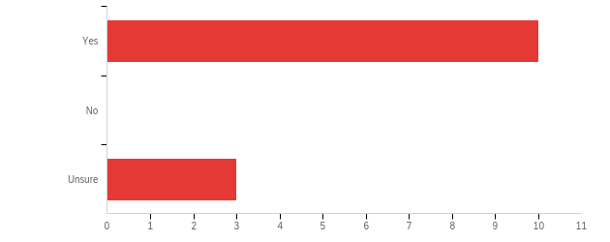
Q15 - If introduced; would you be interested in having a mental health app that was in partnership with the University?
Q15.1 - What qualities or features would you like on a mental health app?
Veterans and PTSD and Military Counseling
Meditation, breathing exercises, resources.
Quick appointment making procedure, list of relaxation events/events in general with easy sign up for said events

Slide 64
Current Undergraduates (Final Survey)

Slide 65
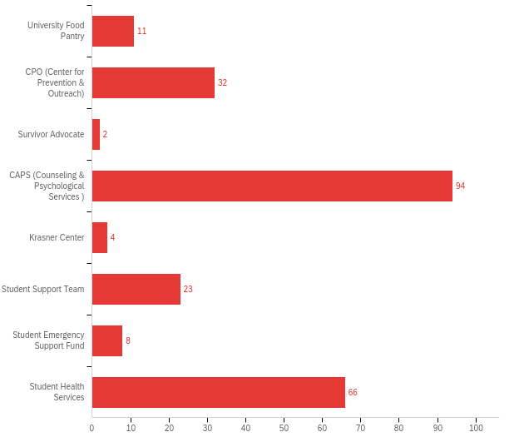
Q1 - Select any of the following services if you've used them previously:
Notes:
Anna

Slide 66
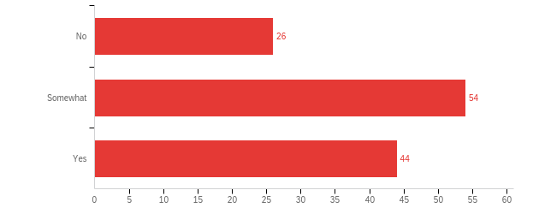
Q2 - Did your use of the service(s) match your expectations of it?
Notes:
Anna

Slide 67
Q2.1 - If you have used one of these services, what suggestions do you have to improve the student experience?
It takes a very long time to start counseling at CAPS, which deters a lot of students from signing up because they often need to start right away.
It doesn't seem as if CAPS ever has enough appointments available or the best system for scheduling follow-ups.
If the service cannot provide what the student is seeking, they should tell the student right away. I was on a waitlist at the Krasner center for ADHD counseling only to find out months in that they in fact, do not offer therapy on that issue. Had I known sooner, I would have tried to find an off-campus provider instead of waiting for nothing.
I did not necessarily have a bad experience with my counselor, but it felt like this person was giving me the same generic advice every week and was not very invested in my problems. I think things would have been different if I was able to be in person.
CAPS was very helpful in referring me to an external provider, however I feel that once my case was passed along I was not able to seek continued support from university services. The Student Support Team was very empathetic to whatever I came to them with, however it felt as if their reach did not extend to my professors and there was no real effect when it came to juggling my schoolwork.

Slide 68
Q2.1 - If you have used one of these services, what suggestions do you have to improve the student experience?
Not all of the people at CAPS were great. I was having difficulties booking an appointment and they were snappy and dismissive during my first intake. Some of the people I've spoken to at Let's Talk were also not helpful and didn't seem good at communicating. Also, I think having phone calls as the only way to book appointments and do intakes is extremely outdated. As someone with anxiety regarding phone calls, I think at least having email capabilities would be a helpful alternative option.
Allow in-person sessions. It was difficult to find a private area where I could speak with the counselor during my appointment. I had issues with my roommates that really affected me and I could not speak in my room. I am not excited to return to campus. I had two sessions before they recommended I speak to a professional. I wish I had access to a professional counselor on-campus.
Please do not recommend out patient cares where on Google Maps it can be seen that every person of color that has visited it has reported incredible racial discrimination.
A better communication system. They have a specific system of communication and it is hard to remember/access it. A better way would be though our school email instead of contact thought the health portal. You don’t get notifications from there so it’s hard to stay updated.

Slide 69
Q2.1.a - You mentioned that your use of the service(s) did not match your expectations. If possible, please elaborate including what suggestions do you have to improve the student experience?
When I went in there, they immediately thought I was suicidal. I thought I’d be getting counseling from caps to help me. Instead I was greeted by a student counselor who clearly has no idea what she’s doing and although I told her my expectations and needs and she apparently just gave up on being my counselor.
Both CAPS and the Student Support Team are marketed as places where students can go when they are struggling to succeed academically amidst other situations. However, when you actually go to them for help, they only address the immediate concern and do not offer real support. Oftentimes, professors take these with a grain of salt and no real change is made.
Hotline counselors are more concerned with putting me in a mental hospital and keeping me there than in retaining its students. This shows me an incredible callousness and lack of concern on the university's part. I don't know if you understand that I am here to find solutions and stay in school, not have UPD knock down my door and forcibly admit me.
CAPS - Never enough therapists, most therapists don't follow through on communication or commitments. They seem to only care about student mental health if students are going to pose a threat to themselves or someone else. (I've even gotten a "learn to deal with it" response from CAPS therapists)
Student Health Services - They tend to view students as individuals who either want to get out of class or something else. They are always untrusting of the students and it makes the visits much tougher for students. As an international student, my only source of medical help is Student Health Services and the last thing I expect is a hostile doctor who probably thinks I'm lying about my illness.

Slide 70
Q2.2 - If you have not used any services, why not? Is there anything you would change about this service that would make you more likely to utilize it?
My English is poor, I am afraid that I cannot express the meaning of my feeling
Fear that it won’t be much help and due to time management, can’t find the right timing to go there.
I never knew where to find these services and being a commuter makes then less accessible
I just recently reached out to the student support team and so far they’ve been very accommodating! I honestly struggle to ask for help and I think a lot of other students do, so I think that it would be great for a mass email to be sent to the student body initiating a conversation. Maybe a mental health check-in survey or questionnaire that students can fill out with links to who to contact on campus would be helpful!
I’ve heard things from friends who have used these services that were very negative.
The process was difficult for me to register into CAPS
I tried to make an appointment with CAPS in the past but it is difficult to make one as they fill fast. I wasn't aware that those other services existed or merely heard of them, but never needed to use the other services.

Slide 71
Q3 - How can the faculty/your professors at Stony Brook be better in terms of caring for your mental health?
Faculty should be better informed about the services on campus that can actually help students with these issues.
Mental health days should be granted like a sick day with no negative consequences on one's grade.
Professors tend to assign work or exams the same dates as other professors. It would be great if there was a way to spread the work out. Students should be allowed a certain amount of excused late hours for assignments each semester.
Faculty can be more upfront and have better conversations and check ins with their student population especially considering the conditions in the world. We need to integrate these conversations into school to help make better professionals of tomorrow. These conversations can potentially save a life.
More understanding of extraneous circumstances (such as deaths in the family). The humanities professors are generally very kind, but the STEM professors will believe it is a sign of self pity.
Too much workload does not leave me with time to attend campus events, dedicate significant time to extracurriculars, nor build and maintain relationships with friends.

Slide 72
Q3 - How can the faculty/your professors at Stony Brook be better in terms of caring for your mental health?
Altogether, professors are people too. The way they’ve grown, learned, and maintained their life values informs how they currently teach and come across to students. Unfortunately, this means cultural and age barriers that make it difficult for them to understand the urgency of mental health crises. For example, I needed a day for mental health this semester because of personal trauma and all around stress bogging me down heavily. My professor did not understand, and simply reminded me that if I continue to be absent, my grade will suffer. This is not helpful. I can’t blame him and there’s no meaning to be upset - he’s elderly and has experienced teaching several generations of students. I understand his end, but he fails to understand mine. That’s the fundamental divide between some professors and their students - the lack of understanding and trust that their student is actually in a crises or urgent situation.

Slide 73
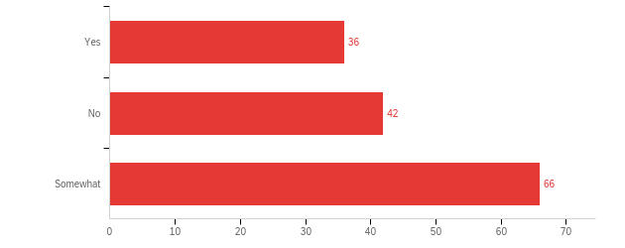
Q4 - Would you say that the advertisement of mental health services on campus is accurate to your experience of these services?
Notes:
Nylette

Slide 74
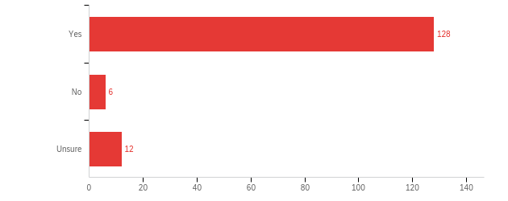
Q5 - Should the University introduce mental health services during Orientation?

Slide 75
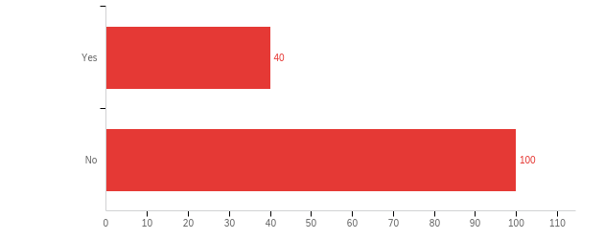
Q6 - Are there any mental health services not already provided by the University that would you like to see?

Slide 76
Q6.1 - Please explain/elaborate on what services you would like to see the University provide to students for their mental health?
Time management and deadline workshops. Maybe even advertised study groups set up by TAs or the professors of the classes.
Ways to connect to long term mental health counselors and advocates for students dealing with issues with policy due to their mental health.
A focus on trauma, psychological disorders, and care for minorities would help. Perhaps a queer therapy program.
Eating disorder support
An informal place (like the student union) where individuals working under SBU could talk to students and help alleviate concerns.
I think peer support groups would be a good idea to try. Many students who I know on campus that struggle with mental health often discuss their struggles with other students because of the lack of mental health support on campus.

Slide 77
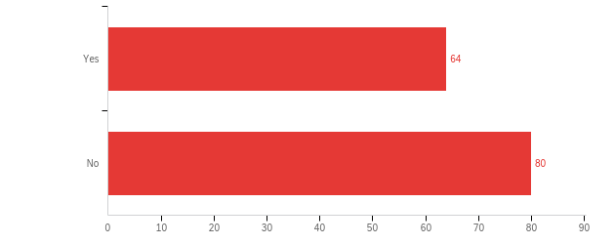
Q7 - Have you attended any events or student programming related to mental health? (I.e hosted by USG, CPO, an RA, etc)

Slide 78
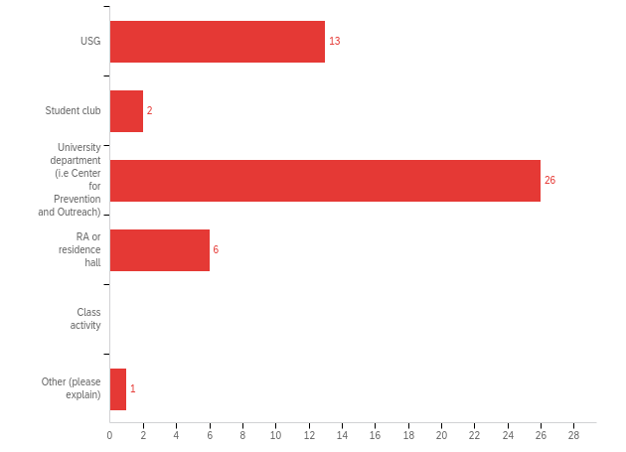
Q7.1 - Which department or student-led organization hosted the event?

Slide 79
Q7.2 - After attending the mental health event did you find it helpful or a hindrance to your mental health?
Helpful, I usually love the events with dogs or meditation or plants, etc. It helps to take a beat out of a busy day and relax.
The suicide prevention training was helpful.
I found the self-care passport events helpful to an extent but it might be advantageous to allow students to participate in their own form of self-care instead of doing a class on it. Another idea is having workshops over winter/summer break when students have more time to attend. I would also like to see more events on zoom as a commuter student.
I thought it was informative. However, not everything they mentioned aligned with my previous experiences when seeking mental health support from professionals.
I've gone to the painting workshop a couple times, but I didn't feel a major mental health impact from it. I wouldn't say it was helpful or a hindrance to mental health in particular.
All the work that is done is extremely helpful for students who are not going through a huge mental health crisis. When the students are in crisis, none of the institutions that are advertised at these events are capable of helping them through. I've known survivors of the worst form of trauma get their appointment months after their initial visit. Even upon reaching this stage, the therapists do not have any information or background from the case (which they had previously collected during the initial visit).

Slide 80
Q7.3 - Please share any mental health programming that you would like to see from a University or student resource? (Outside of a specialized department such as Counseling and Psychological Services or Center for Prevention and Outreach)
I would like to see mental health services work in collaboration with professors. A university is only as mental health aware as it’s faculty is, after all.
I think integrating it more into each department would help at least make it look like the administration actually cares beyond just sending performative emails.
I think that students would benefit from being a part of more holistic modes of therapeutic treatment such as mindfulness New Age activities again animal therapy etc. Additionally I feel if the mental health services were given across platforms such as like text messages it would be beneficial for students who would want to remain anonymous that way if they feel uncomfortable with speaking over the phone or speaking over zoom etc. they don’t have to and they get all their identity also can remain concealed

Slide 81
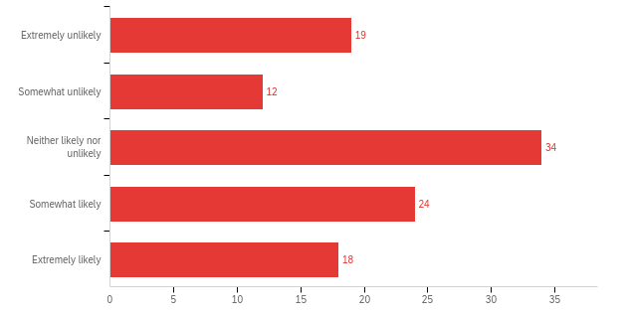
Q8 - In response to previous survey results Counseling and Psychological Services has introduced a Student Experience and Satisfaction coordinator who will "listens to and responds to your compliments and concerns related to CAPS. The coordinator addresses your questions, openly hears your feedback, and helps resolve problems about accessing care, your recent visit, or the care received by our counseling team." How likely would to share your concerns about your interactions with CAPS with the student coordinator?

Slide 82
Q8.1 - Please elaborate on the reason why you would likely or unlikely you would share your concerns with the Student Experience & Satisfaction Coordinator?
The Student Experience & Satisfaction Coordinator is actually willing to listen to students' questions and concerns about accessing care.
It is hard to find someone who can spend time talk to me, and worry about me when I was depressed
I'd love to see someone open to feedback for CAPS. I've struggled to find appointment times in the past and could've really used someone whose job was to help problem-solve in that area in order to improve my mental health.
If I had a serious enough grievance, yes, but it's unlikely anything would rise to that level of concern.
I don't know if I can trust the person
The program leaves little time to do extra activities.
I guess I wouldn’t mind sharing, but my schedule is kind of packed to brim preparing for finals so I wouldn’t know when I would get the time. I honestly have doubts that any meaningful change will occur. If the class evaluation site is any indicator, I would say most complaints by students often fall on deaf ears. Students across years could have the same complaints about one or multiple professors, yet the professor does not make an effort to change, and their department just ignores the issue. I imagine addressing any complaints to this student coordinator would be a waste since nothing meaningful will come out of it.

Slide 83
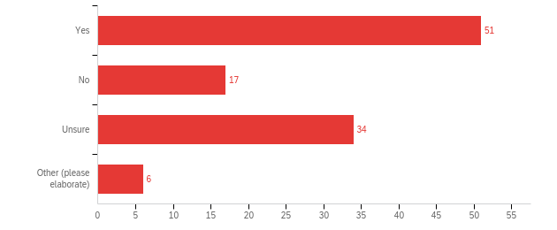
Q9 - If introduced; would you like to see crisis messaging (i.e a pop-up advertising emergency services) prior to entering the CAPS/CPO/ student health website?

Slide 84
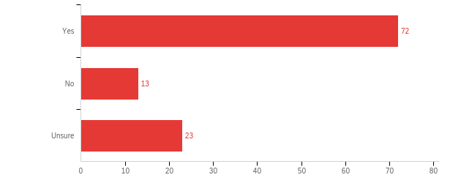
Q10 - If introduced; would you be interested in having a mental health app that was in partnership with the University?

Slide 85
Q10.1 - What qualities or features would you like on a mental health app?
resources on juggling mental health and academics
meditation, meeting with someone online, check ins, tips, articles
making like a daily tracker to trace your mental health
effective treatments to particular symptoms/mental disorders
easy accessibility to create and view appointments and get in contact with help
daily notification to check in to select your mood at the end of the day. If a student is not doing well you have the option to speak to someone.
connects you to counselors/trained professionals, resources you can use specific to the problem you’re facing, ways to discuss with others the stuff you’re going through
affirmations, reminders, quotes of the day
a talk feature maybe? or a forum so you can read that you’re not alone

Slide 86
Discussion & Recommendations
Notes:
Move on to our discussions and recommendations

Slide 87
Recommendations
Web
Evaluate and update websites of CPO, CAPS, and other resources to promote easier student access
CAPS appointment tools and interface of Wolfie Portal
Navigation issues
Emergency resources at the top of a page or via pop-up
Specialized care connections/referrals
Solicit additional student feedback on website design
CAPS
Offer in-person initial consultations
Promote clear expectations and responsibilities of services including CAPS
Increase collaboration with external mental health services to better coordinate with students
Utilize the career center model to bring introductory resources to students
“Mental health anywhere” / “Doc in the dorms”
Reduce barriers to continuing care by fostering a more welcoming environment for students seeking help
Increase coordination with resources for students in need of more specialized care

Slide 88
Recommendations
Faculty
Increase ability of faculty and staff to share campus resources with students or direct them to resources
Encourage receptiveness to student concerns through interactive teaching modalities
Facilitate greater dialogue between faculty/staff and administration on their unique needs with regards to mental health and methods of support
University
Credit bearing class on resources offered
Consolidation of newsletters into one resource
Increase grant capital by looking at wellness as an investment and not a byproduct
Better orient resources for commuters
Address concerns of students who cannot access external services due to lack of transportation
Potential usage for mental health funds
Integrate mental health resource training into orientation
Investigate potential implementation of mental health apps, including privacy issues

Slide 89
Thank You!

