Slide 1
Procurement Overview
New Hire Orientation 2024

Slide 2

Thank you for joining our institution!
Our team of procurement professionals are ready to support your needs and we welcome the opportunity to partner with you.
As a state agency and as a recipient of federal funds, we have many requirements governing purchasing, expenditures, and travel.
Please stay in touch and let us know how we can help you!

Slide 3



Procurement Vision, Mission, & Values
To be a trusted full-service procurement partner and leading source-to-pay organization by creating value through strategic thinking, efficient processes, technology systems and exceptional customer care.
To serve, support, and collaborate with our customers and each other so we can deliver innovative, timely, and accurate solutions that create value and streamline processes in support of the University Community’s strategic priorities and objectives.
Accountability | Appreciation | Collaboration | Fun | Professionalism

Slide 4

Procurement Overview
Sourcing
Sourcing is tasked with carrying out research, developing category management, and creating and executing strategic sourcing competencies.
Contracting
Contracting engages in negotiating and developing contracts to procure goods and services at a reasonable price, on time and within the specifications to meet University needs, State and Research compliance.
Central Services
Central Services operations includes Mail Services, Central Receiving, Property Control, and Archives Management. These areas receive materials and equipment, sort and deliver campus and hospital mail, manage thousands of assets, and perform physical inventory of capital assets annually.
WolfMart
WolfMart 360 is Stony Brook’s source-to-pay e-Procurement system that allows purchasers to quickly locate and buy products and services from University contracts and preferred suppliers.
Travel
The Travel Office is responsible for travel expense reimbursements, managing SBU’s travel management company, Direct Travel and administration of the Concur system for the Campus, Hospital, and LIVH.
Accounts Payable
AP provides the Campus Community with efficient and professional support for the payment of goods and services in support of the University's educational, research, healthcare, and administrative needs for State, RF and LIVH.
Supplier Diversity
The supplier diversity program ensures that MWBE and SDVOB businesses have a full opportunity to compete for the University's business.
Credit Cards
The Procurement Office administers all Credit card programs. Cards are available to both RF and State employees.

Slide 5
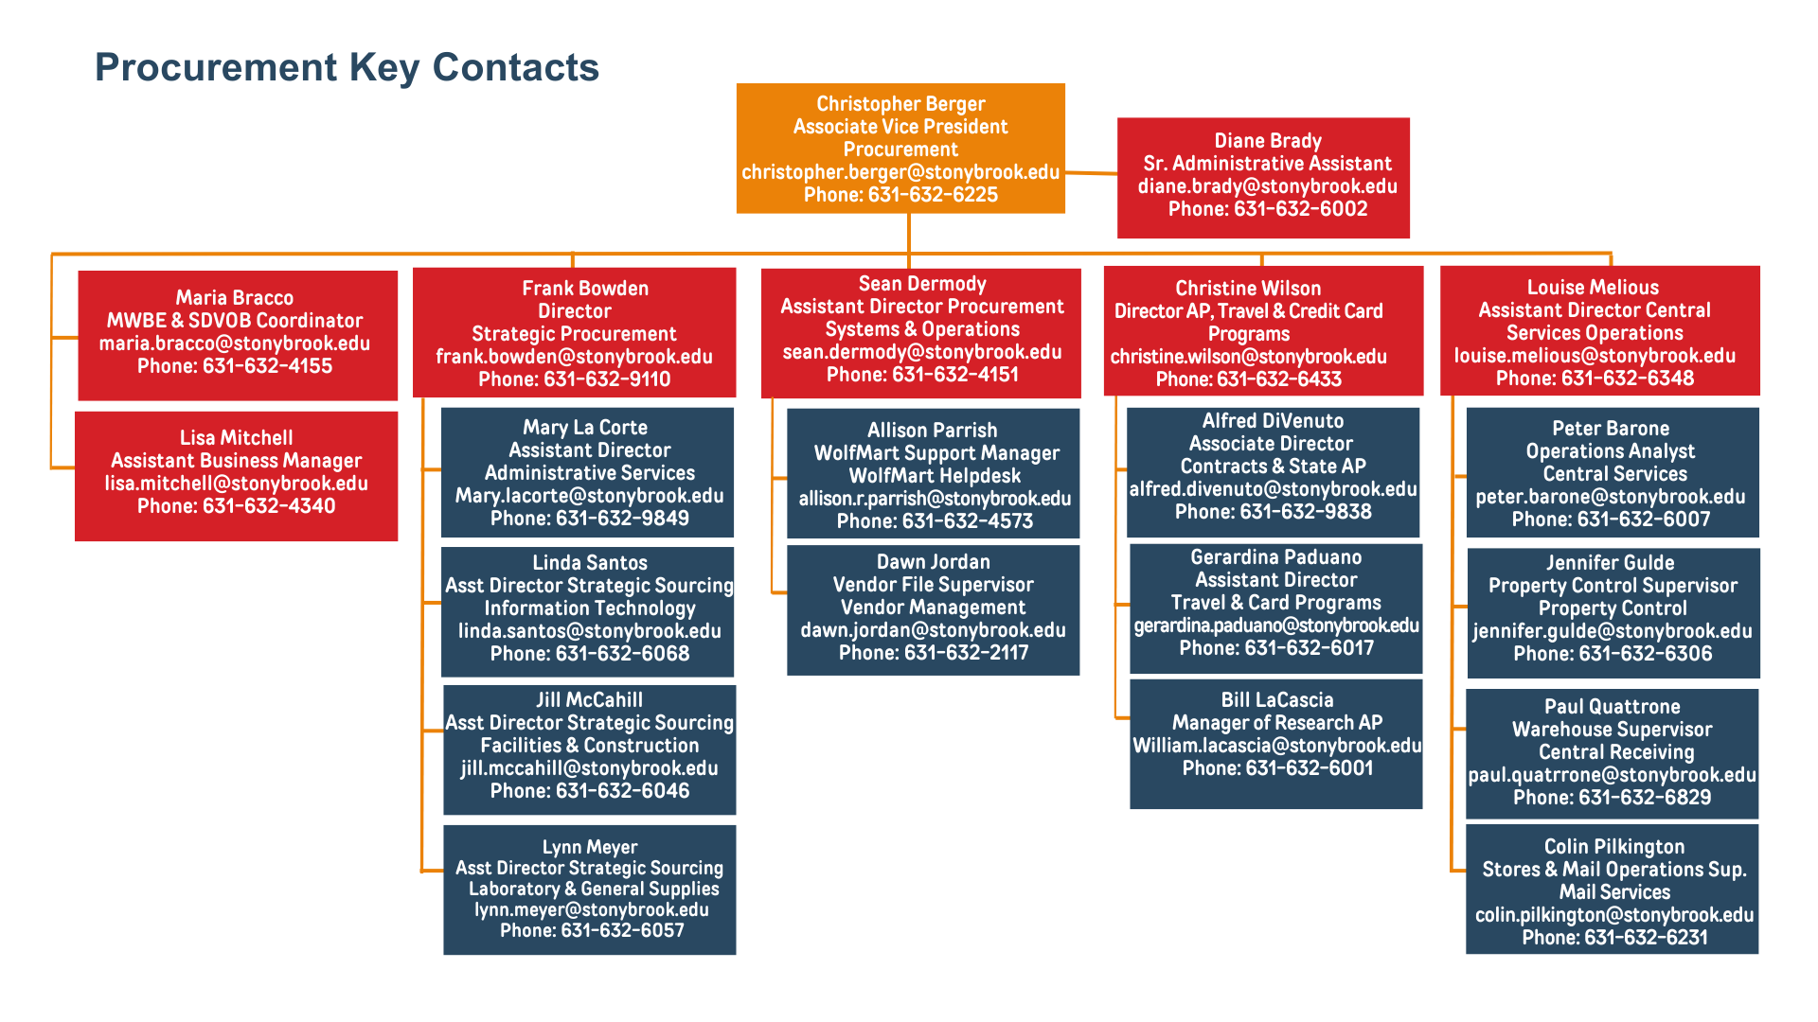
Procurement Organization – Key Contacts

Slide 6
Sourcing & Contracting Team
Our goal is to procure goods and services of the proper quality and quantity, at a reasonable price in time to accommodate your needs
Making a Purchase
Your Buying Team
(Four Purchasing Categories)
Information Technology & Telecommunications
Administrative Services
Construction, Trade Services & Transportation
Campus & Research Operations
Link: 4 Purchasing Categories
Thresholds, Guidelines & Policies
New York State Finance Law - State Purchasing
Link: NYS Finance Law Article 11
NY State Purchasing
Link: State Purchasing
Research Foundation Purchasing
Link: Research Foundation Purchasing
Revenue Contracts
Link: Revenue Contracts
Stony Brook University-wide Policies
Links: SBU Policies P613 / SBU Policies P614
New York State Executive Orders
Executive orders are written instruments through which the Governor can issue directives to shape policy. See Appendix for a listing of all Procurement-related Executive Orders
Programs, Regulations & Controls
SUNY Purchasing Procedures
Link: SUNY Purchasing and Contracting 7553
Link: SUNY Construction Contracting 7554
RF Purchasing Procedures
Link: Research Foundation Procurement Policy
Supplier Diversity
Link: MWBE & SDVOB Information
Link: SUNY MWBE Procedure 7557
Contract Signatories
Never sign a supplier contract. Only Authorized Signatories may sign these contracts.
Lobbying Law Restricted Period
Once a competitive bid is released and before it is officially awarded, only an authorized designate (Procurement) may speak with a supplier.

Slide 7
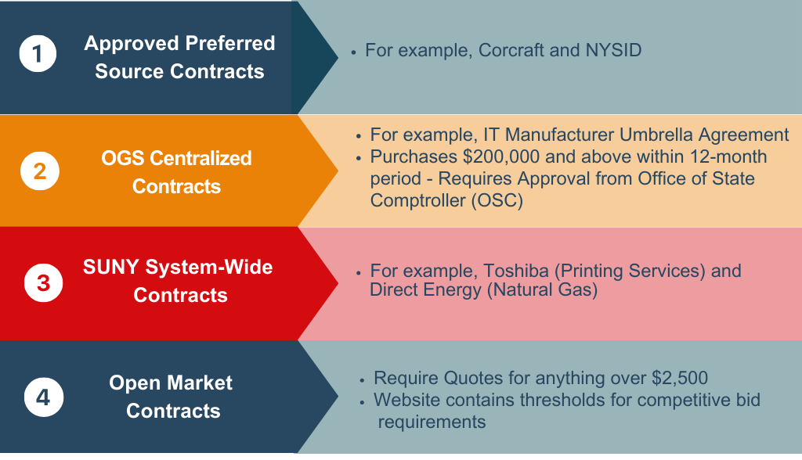

State Purchasing Guidelines
New York State Procurement Hierarchy
Avoid single/sole source - State always wants to see competition.

Slide 8
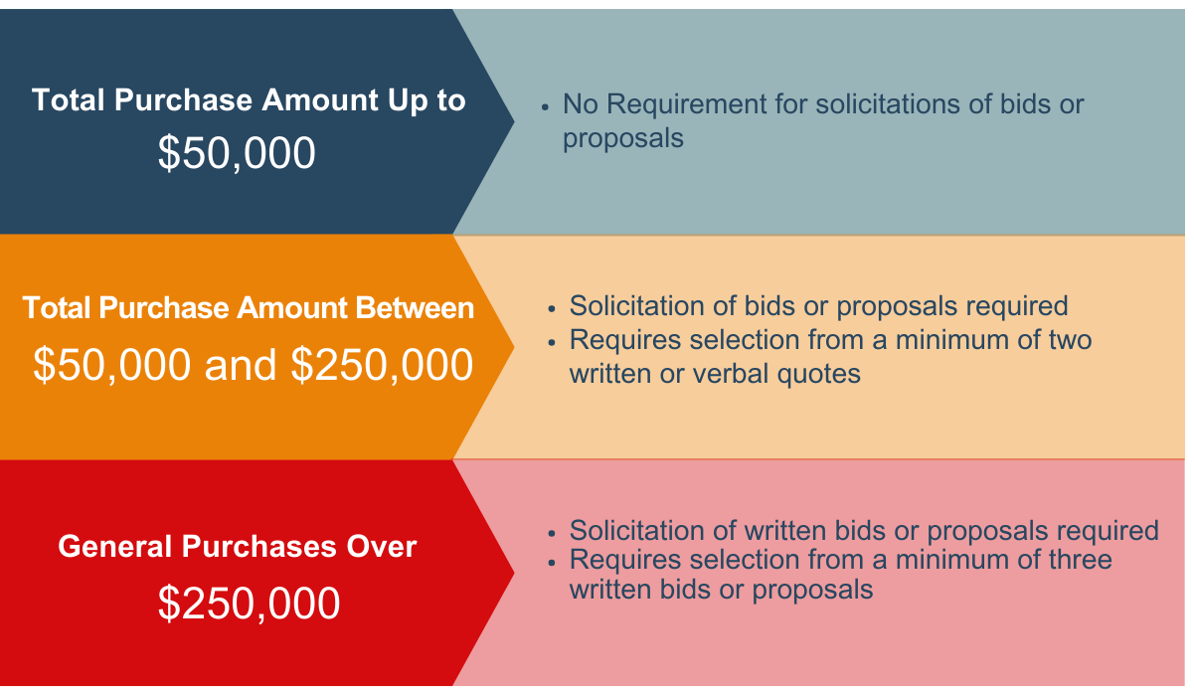
RF Buying Guidelines
Competitive Bid Thresholds
NYS Agencies and the RF of SUNY are tax exempt entities.

Slide 9
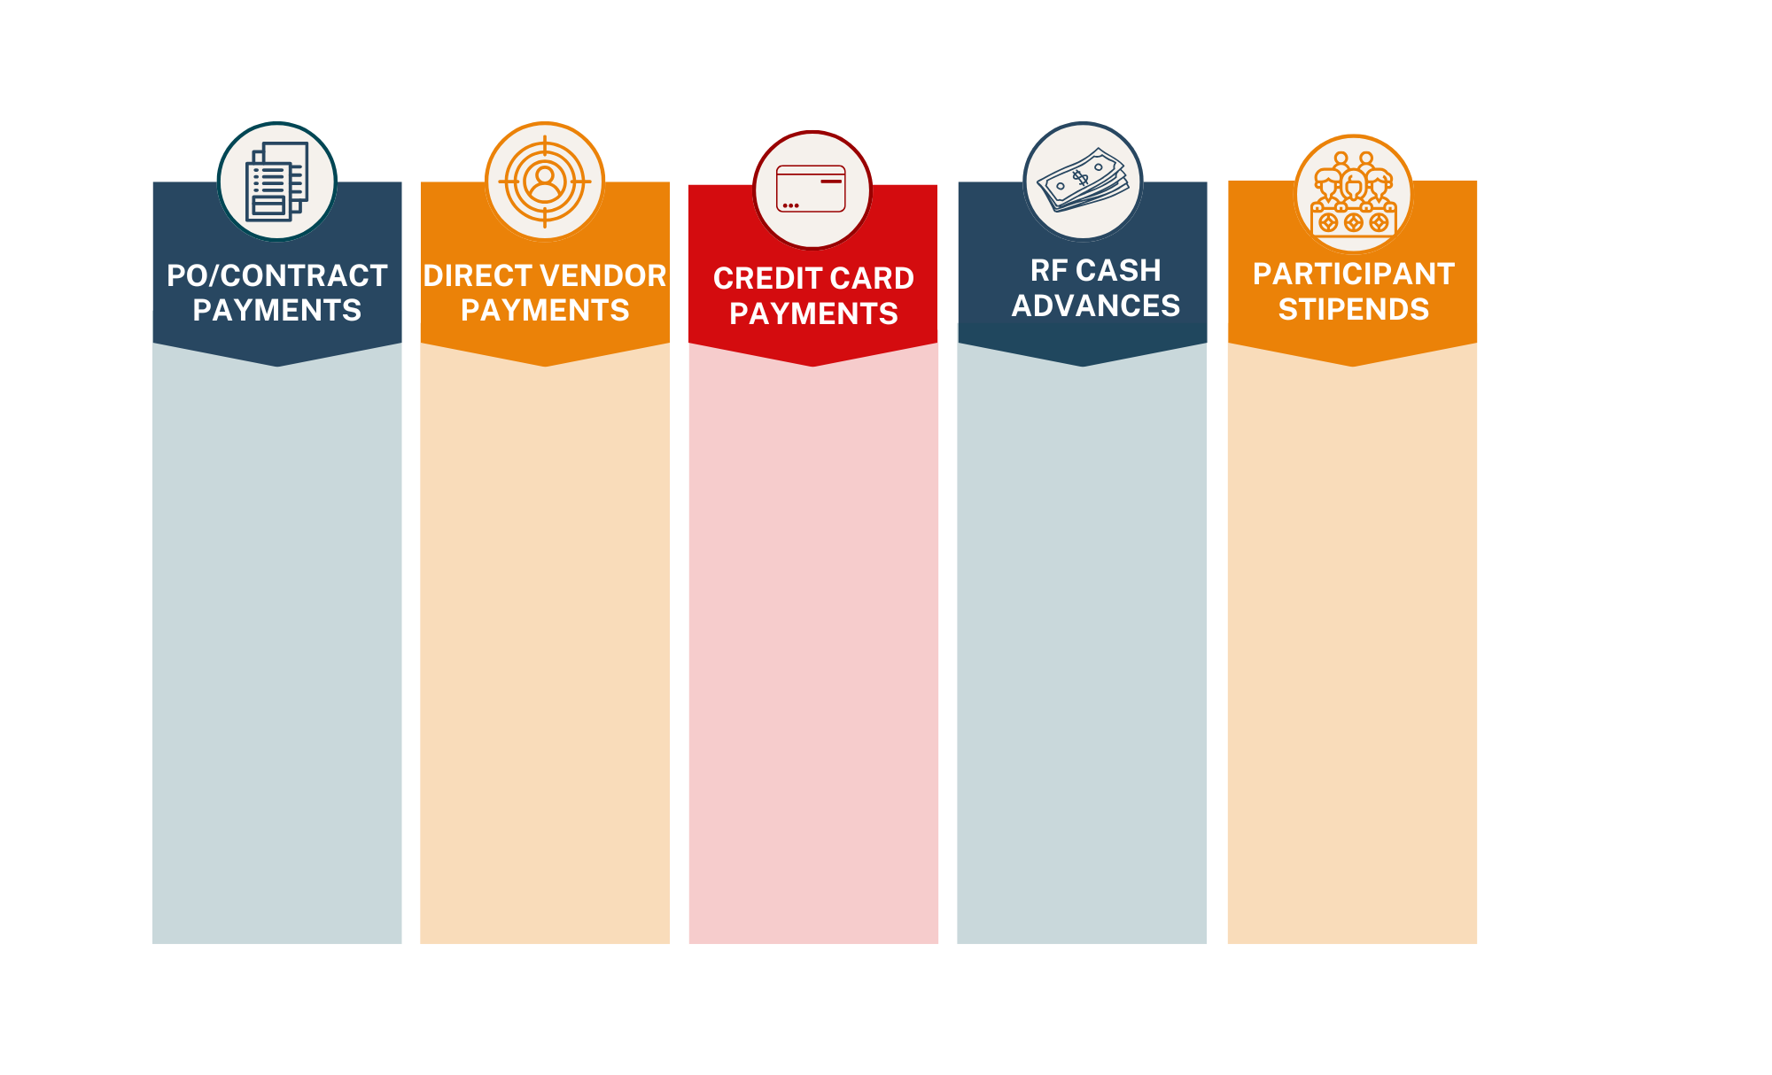
Accounts Payable
SUNY/RF Payment Types
For State and RF guidelines visit: stonybrook.edu/commcms/procurement/employees/payments
Send State and RF Invoices to accountspayable@stonybrook.edu
Send State Contract invoices to contractpayable@stonybrook.edu
Send LISVH invoices to accountspayable_LISVH@
stonybrook.edu
Accreditation fees, Memberships, Subscriptions, Visa Fees
Funds are not encumbered
RF Credit Card is for travel and small business expenses
State credit cards are available for individual travel and P-Cards
Used for payments to Human Subjects
Used for research field expenses
Nonwage support payments
Administered by RF, e.g. summer research students
Understand the different funding sources: RF, IDC, State
All payments are subject to audit and departments must be able to justify and support receipt of the goods or services.

Slide 10
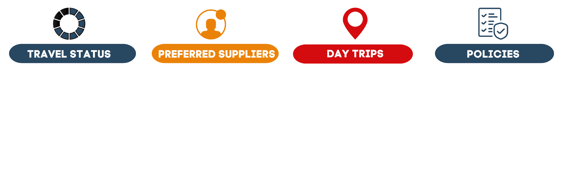
Travel Program
Key Points to Keep in Mind when Traveling
Must be engaged in official State or RF business
At least 35 miles from their designated official station and their place of residence
Direct Travel is SBU’s new TMC, holds SUNY Contract and is a Concur partner
Hertz and Enterprise are on an OGS contract, insurance is included, any vehicle higher than Standard class must be justified
To claim expenses must be in Travel Status
Mileage reimbursed at current IRS rate
Must leave before 7 and return after 7 to be eligible for breakfast/dinner per diems. (Do not use your travel card for one day meals.)
Business travel must be necessary, reasonable and appropriate.
Visit stonybrook.edu/commcms/travel-and-expense for all SUNY, RF Travel & Card Program Guidelines.

Slide 11

Travel Credit Card Programs
Key Points and Resources
State Procurement Card Program
Ellen Kaufman, P-Card Administrator
State and RF employees may apply for a JP Morgan Chase P-Card for small dollar purchases. The P-Card is an alternate method of payment and is not intended to evade Stony Brook University’s procurement policies.
Ellen.Kaufman@stonybrook.edu
(631) 632-6226
State Travel Card Program
Joanne DeSantis, T-Card Administrator
State employees may apply for a individual JP Morgan Chase T-Card to purchase their travel.
Joanne.Desantis@stonybrook.edu
(631) 632-4031
State NET Card Program
Joanne DeSantis, T-Card Administrator
State employees may apply for a JP Morgan Chase NET Card to purchase non-employee travel. Non-employees as defined by NYS may include RF employees, students, candidates, and guests.
Joanne.Desantis@stonybrook.edu
(631) 632-4031
RF Procurement/Travel Card Program
Thomas Friebolin, RF Card Administrator
RF and State employees may apply for a BOA credit card for small dollar purchases and travel. The cardholder may also use their card for non-employee travel needs.
Thomas.Frieboliin@stonybrook.edu
(631) 632-6008
Visit stonybrook.edu/commcms/travel-and-expense/credit-card-new for all SUNY, and RF Credit Card Program Guidelines.

Slide 12

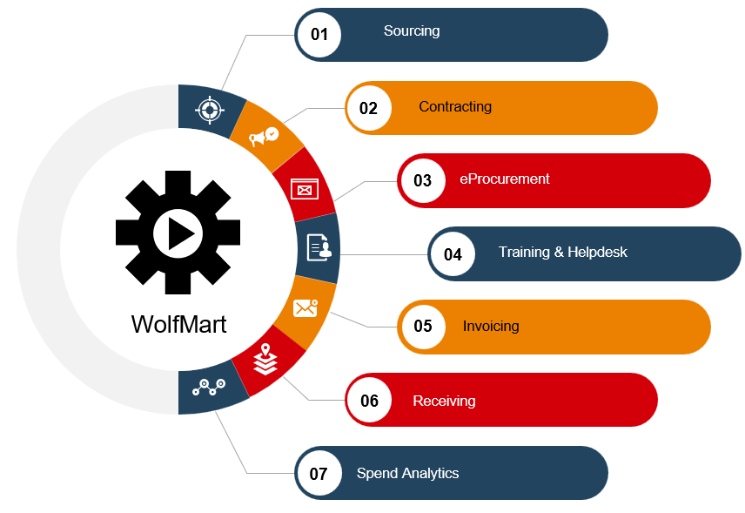
Procurement Data Systems
Most of your Procurement Needs can be met through one of two systems:
  Automates and expedites the travel reimbursement process
  Mobile on-the-go features
  Systematically supports travel and expense policy compliance
For all Concur Guidelines and Training visit: stonybrook.edu/commcms/travel-and-expense/concur
  Uses Jaggaer eProcurement System
  Supports electronic requisitions, purchase orders, and payments
  Used for issuing sourcing events and repository of procurement contracts

Slide 13
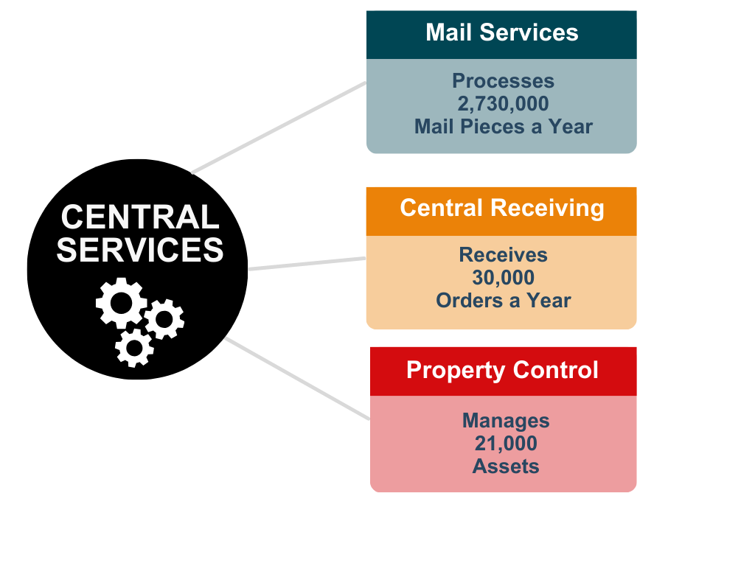


Central Services
At a Glance
30 FTE
16 Vehicles

Slide 14
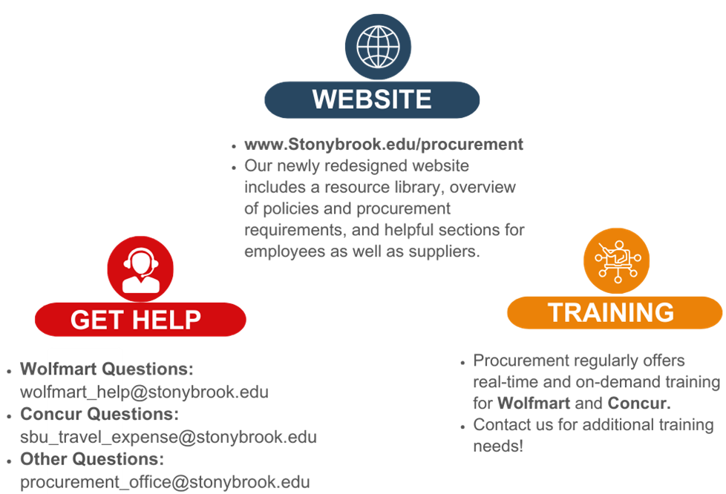

Resources
Procurement can be complicated. Here are some ways to get help when needed.

Slide 15

Thank You

Slide 16
Appendix

Slide 17
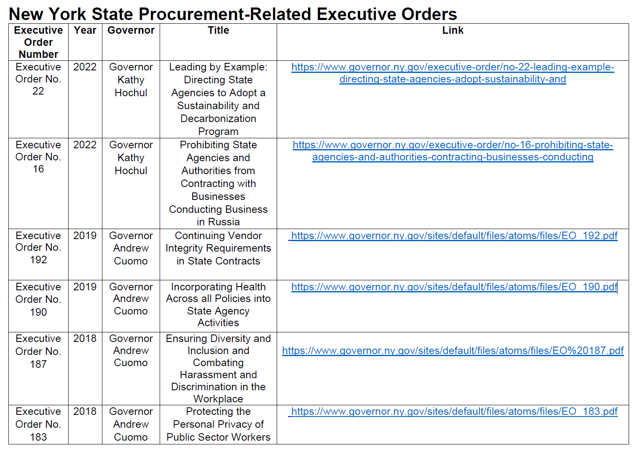
Making a Purchase

Slide 18
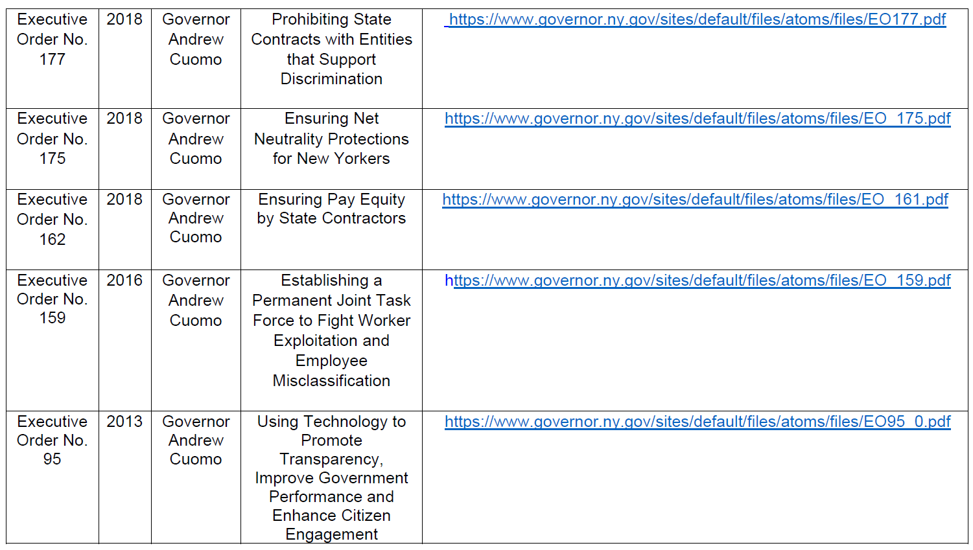
Making a Purchase
New York State Procurement-Related Executive Orders

