Slide 1
Conflict of Interest
Information for this module came from the
Office of Research Integrity (ORI) website:
https://ori.hhs.gov/content/Chapter-5-Conflicts-of-Interest-Introduction
and the National Institutes of Health, 2015

Slide 2
Overview
This presentation will provide guidance regarding real or potential conflicts of interest in research and how to avoid them.

Slide 3
Objectives
Participants will be able to:
Define financial conflict of interest
State what comprises a non-financial conflict of interest
Give examples when conflict of interest occurs

Slide 4
Researchers have an interest in not only advancing research in their field but in protecting the participants in their research. Researchers can have personal interests that affect their research such as:
Spouse’s job
Stock holdings
Outside positions with other institutions
Membership in professional organizations

Slide 5
Conflict of interest is when a Researcher is, or may be, in a position to influence activities or decisions in the conduct of activities in ways that could lead to personal financial gain for the Researcher (and/or the Researcher’s immediate family member), or give an improper advantage to third parties in their dealings with the University.

Slide 6
Conflicts of interest may also arise when Researchers (and/or the Researcher’s immediate family member) have outside obligations of any kind that are in substantial conflict with the Researcher's university responsibilities or the public interest.

Slide 7
To whom Does This Apply?
Individuals who have a decisional role in a specific research study
Individuals who are influential in the design, conduct, or reporting of a research study
Obtain informed consent
Make decisions about who is eligible to participate in a study
Participate in the analysis of data
Participate in the interpretation of data

Slide 8
To Whom Does This Not Apply?
Individuals who participate through isolated tasks incidental to the research (e.g., scheduling subject tests)
Individuals who perform routine care for subjects participating in a study

Slide 9
Financial Interest
Any remuneration to the Researcher (and/or those of the Researcher’s immediate family member(s)) from outside the University, and/or
Any equity holdings or ownership of the Investigator (and/or those of the Researcher’s immediate family member), and/or
Intellectual property rights and interests (e.g., new technology disclosures, patents, copyrights) where a company has entered into an option to license such rights and interests from the University.
Intellectual property rights and interests upon receipt of income related to such rights and interests.
NOTE: All royalties, including those received by the Investigator from this University, are to be disclosed.

Slide 10
Financial Interest Exclusions:
Income from investments, such as mutual funds and retirement accounts, as long as the Investigator does not directly control the investment decisions made
Income from seminars, lectures or teaching engagements sponsored by a federal, state or local government agency, a (United States) institution of higher education as defined at 20 U.S.C. 1001 (a), an academic teaching hospital, a medical center, or a research institute that is affiliated with an institution of higher education
Income from service on advisory committees or review panels for a federal, state or a local government agency, a (United States) institution of higher education as defined at 20 U.S.C. 1001 (a), an academic teaching hospital, a medical center, or a research institute that is affiliated with an institution of higher education.

Slide 11
Personally accepting payment from the research sponsor for non-research travel or other gifts | Serving as a director, officer, or other decision-maker for a commercial sponsor of a clinical research study
Obtaining royalties or being named as an inventor on patents for the products being evaluated in the clinical research or products that could benefit from the clinical research | Holding stock or stock options with a commercial sponsor of clinical research (unless the amount held is below a specific threshold)
Receiving payments based on the research recruitment or outcomes | Receiving compensation for services as a consultant or advisor to a commercial sponsor of a clinical research study
Having personal or outside relationships with the commercial sponsor of the clinical research | Receiving honoraria from a commercial sponsor of a clinical research study
Serving on the board of directors or scientific advisory board of an organization that provides financial support for the employee to conduct university research | Having financial interest above the applicable established levels in companies with similar products known to the investigator to be competing with the product under study

Slide 12
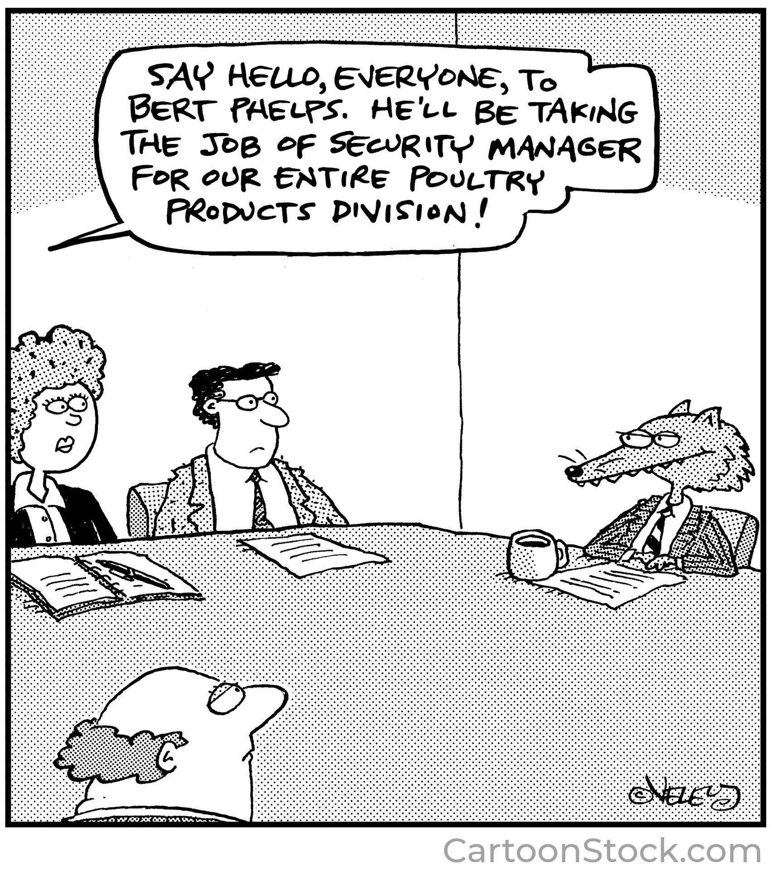

Slide 13
Case Example (1)
Dr. Smith has written a textbook from which he receives compensation. Each semester, he requires that his students purchase his textbook as required reading for the course.

Slide 14
Case Example Questions (1)
Does a conflict of interest exist?
Does the individual need to disclose the conflict?
Should the student be required to purchase the textbook written by the professor?

Slide 15
Case Example (2)
Professor Dupont is a scientist working in the field of chemical safety. His lab conducts basic and applied research. In addition to research, Dr. Dupont also conducts contract testing for private firms and government organizations. Professor Dupont has been asked by chemical companies to work on a variety of chemical safety plans. The Chemco company has recently contracted with Professor Dupont for some consulting time during the next 12 months.

Slide 16
Case Example Questions (2)
Is Dr. Dupont using university resources for his consulting work?
Are graduate students involved in the consulting work?
Does Dr. Dupont have any financial interest in Chemco?
Are Dr. Dupont’s research interests related to Chemco’s activities?

Slide 17
Significant Financial Interest
Appears to be related to the researcher’s institutional responsibilities and includes the researcher’s spouse and dependent children
Publicly traded
The value or remuneration exceeds $5,000 when aggregated within the 12 months preceding the disclosure and can include for example consulting fees, honoraria, and paid authorship
The value of any equity interest (e.g., stock, stock options or other ownership interest) when aggregated exceeds $5,000 within the 12 months preceding the disclosure

Slide 18
Significant Financial Interest
Appears to be related to the researcher’s institutional responsibilities and includes the researcher’s spouse and dependent children
Non-Publicly Traded
The value of remuneration exceeds $5,000 when aggregated within the 12 months preceding the disclosure and can include for example: consulting fees, honoraria, and paid authorship
The value of any equity interest (e.g., stock, stock options or other ownership interest)

Slide 19
Significant Financial Interest
Appears to be related to the researcher’s institutional responsibilities (can include the researcher’s spouse and dependent children)
Intellectual property rights and interest (upon receipts of income related to such rights and interests)
Patents
Copyrights
Licensing agreements
Trademarks

Slide 20
Significant Financial Interest
Travel related to institutional responsibilities
Occurrence of any reimbursed or sponsored travel (paid on behalf of the researcher and not reimbursed to the researcher so that the exact monetary value might not be readily available) and which totals > $5,000
NOTE: Travel disclosures must include the following information: sponsor, destination, duration, and purpose of the travel

Slide 21
Education
Required every 4 years
Education is required immediately when:
Financial conflict of interest policies are revise in a manner that changes research requirements
A researcher is new to the organization
A research is non-compliant with financial conflict of interest policies and procedures

Slide 22
Disclosure
Annually
Update new significant financial interests within 30 days of acquisition or discovery
NOTE: Failure to disclose may result in disciplinary action

Slide 23
Management Plan
A management plan is needed when an employee has a financial interest, relationship or other circumstance that has the actual, potential or perceived ability to impair their objectivity while performing university duties or participating in research at the university.
Its purpose is to formulate a strategy to mitigate or eliminate risks to the employee’s objectivity
It outlines a plan of the steps that will be taken to manage an employee’s situation so that their objectivity will not be compromised while performing university duties and participating in research at the university

Slide 24
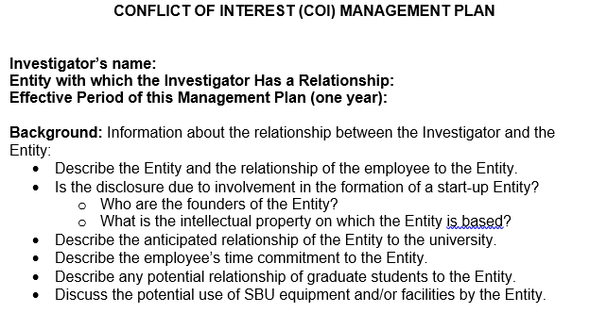

Slide 25
Summary
Conflicts of interest are not uncommon and are not wrong. Conflicts of interest can motivate and encourage good research. However, they present a risk that individuals will prioritize their interests over the responsible conduct of research. In order to protect the integrity of the research, the individuals involved in the research must disclose their conflicts and these conflicts need to be managed

Slide 26
Additional information
Stony Brook University Human Subjects Standard Operating Procedures:
Conflict of Interest in research: section 14
https://www.stonybrook.edu/commcms/research-compliance/Human-Subjects/sops
Stony Brook University P209 Policy:
Disclosure of External Interests & Commitments
https://www.stonybrook.edu/commcms/research-compliance/Conflict-of-Interest-and-Commitment/SOPs

